Slide 1

Adult Care Learning and Development Programmes

Slide 2
Who are Dynamic Training
Established in 2007
Centres in Uxbridge and Hartlepool
Delivering
Apprenticeships
&
Bespoke Training Solutions
Supporting circa 500 learners on a variety of programmes at any one time
Over 80 NHS Trusts choose Dynamic Training with their ongoing Learning & Development Needs
Matrix Accredited.
A Skills for Care Endorsed provider.
A disability confident employer
Part of Calder Holding BV
13 companies with 1000+ employees in the UK and the Netherlands.
Retained our Ofsted “good” inspection grade in June 2025

Slide 3
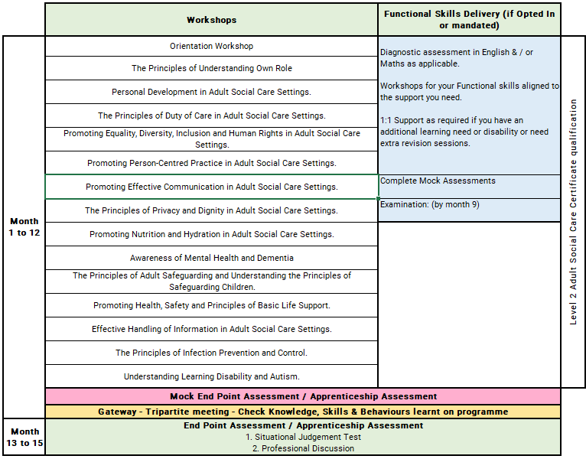
Adult Care Worker Level 2 Apprenticeship
Notes:
Orientation Workshop
Introduction to programme structure, expectations and support.
Using online platforms and digital systems effectively.
Developing good study habits, time management and independent learning skills.
Leading in Integrated Health and Social Care
Understanding leadership roles across health and social care services.
Exploring systems leadership and partnership working.
Leading across organisational and professional boundaries.
Personal Leadership and Emotional Intelligence
Developing self-awareness and reflective leadership practices.
Understanding emotional intelligence and its impact on leadership.
Managing self, relationships and professional resilience.
Effective Communication and Influencing
Developing clear and confident communication strategies.
Influencing skills for different audiences and contexts.
Managing difficult conversations and conflict constructively.
Equality, Diversity and Inclusive Leadership
Understanding equality, diversity and inclusion in leadership practice.
Promoting inclusive workplaces and fair decision-making.
Supporting person-centred, values-based practice.
Neurodivergent Leadership and Inclusive Teams
Understanding neurodiversity in the workplace.
Recognising strengths and challenges within diverse teams.
Creating inclusive environments that support neurodivergent colleagues.
Safeguarding Leadership and Professional Responsibility
Developing safeguarding leadership and accountability.
Applying professional curiosity and sound decision making.
Understanding roles, responsibilities and escalation processes.
Leading High Performing Teams
Supporting team development and engagement.
Building psychological safety and trust.
Managing conflict and maintaining effective team dynamics.
Coaching and Developing Others
Using coaching approaches to support learning and development.
Encouraging reflective practice and professional growth.
Supporting capability, confidence and performance.
Governance, Regulation and Quality Assurance
Understanding regulatory frameworks and compliance.
Governance roles and leadership responsibilities.
Monitoring quality, risk and service performance.
Service Improvement and Innovation
Applying improvement tools and methodologies.
Using data and feedback to strengthen services.
Encouraging innovation and continuous improvement.
Digital Leadership and Information Management
Using digital systems effectively within services.
Understanding information governance and data protection.
Supporting digital innovation to improve outcomes.
Courageous Leadership and Organisational Culture
Developing ethical and values-based leadership.
Encouraging speaking-up cultures and transparency.
Leading change and shaping positive organisational culture.

Slide 4
Off the Job Learning
As part of this apprenticeship, participants complete a minimum of 300 hours of Off-the-Job learning over the duration of the programme.
Off-the-Job learning takes place during paid working hours and supports the development of the knowledge, skills and behaviours required within the Adult Care Worker apprenticeship.
Of the Job learning is essential, mandatory requirement of an apprenticeship to enable the learner and employer to see impactful learning that takes place.

Slide 5
Off-the-Job learning activities include:
Complete the Adult Social Care Certificate.
Knowledge Development
Review anonymised reports or incident summaries to identify risks, mistakes, and areas for improvement. Reflect on these in your learner journal.
Research guidelines, legislation, and laws relating to Equality (e.g., Equality Act 2010, Human Rights Act, NICE guidance).
Study the Online Safety Act 2023 and its implications.
Research into STOMP (Stopping Over-Medication of People with Learning Disabilities and Autism) and STAMP (Supporting Treatment and Appropriate Medication in Paediatrics).
Learn about healthy eating guidelines and their application in the care sector.
Practical Skills
Learn to read vital signs and take physiological measurements.
Understand the symptoms of stroke and how to recognize and manage them.
Explore techniques for supporting healthy relationships for people with learning disabilities.
Research methods to support communication and interactions with individuals who have dementia or learning disabilities.
Learn about nutrition and hydration and how these affect care.
Study the spread of infection and ways to prevent it.
Leadership and Career Progression
Learn about leadership skills and techniques for career progression.
Explore advocate services and their importance in the care sector.
Specialised Topics
Study child exploitation and FGM through government-provided short courses.
Learn more about autism and supporting individuals with learning disabilities.
Additional Reading and Research
Explore resources from organizations such as NHS, NICE, and WHO for deeper knowledge on health inequalities and care standards.
Self-Reflection and Personal Development
Reflect on your values and purpose within the care sector by creating a Career Mission Statement.
Research the term ‘active participation’ and create a reflection in your learner journal about your findings.
Create a One-Page Profile to show how you like to be treated

Slide 6
Progression Opportunities
Learners who complete the Adult Care Worker Level 2 Apprenticeship can progress into more responsible care roles, further training, and specialist pathways within adult social care.
Next-Step Job Roles
Senior Care Worker / Senior Support Worker
Lead Adult Care Worker
Key Worker or Care Coordinator
Reablement Support Worker
Dementia Care Assistant / Specialist Support Worker
Healthcare Assistant in community, residential, or NHS settings
Personal Assistant supporting individuals with direct payments
Shift Leader or Team Leader with experience
Further Learning and Qualifications
Level 3 Lead Adult Care Worker Apprenticeship
Level 3 Diploma in Adult Care
Specialist training in:
  Dementia care
  End-of-life care
  Medication support
  Mental health awareness
  Autism and learning disabilities
  Safeguarding adults
  Positive behaviour support
Longer-term route to Level 5 Leader in Adult Care for management roles

Slide 7
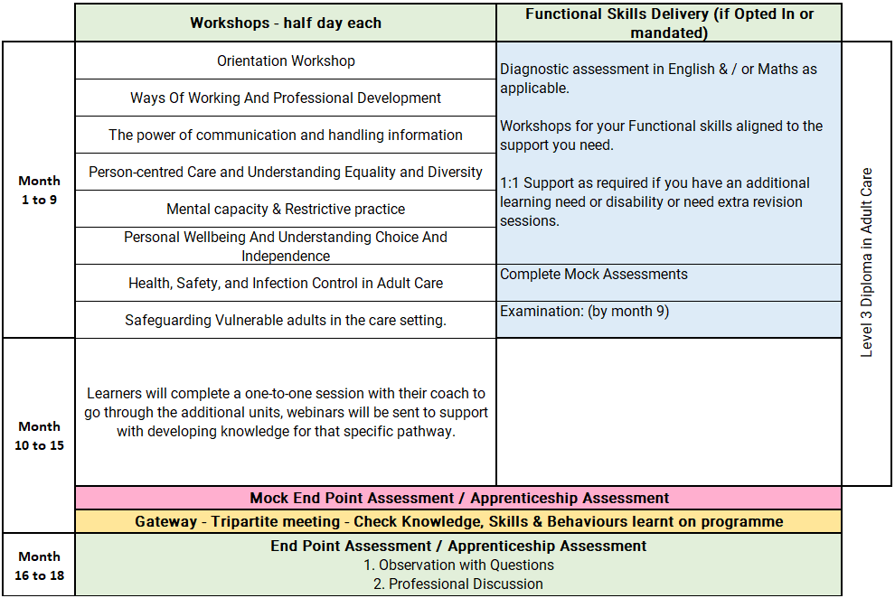
Lead Adult Care Worker Level 3 Apprenticeship

Slide 8
Off the Job Learning
As part of this apprenticeship, participants complete a minimum of 348 hours of Off-the-Job learning over the duration of the programme.
Off-the-Job learning takes place during paid working hours and supports the development of the knowledge, skills and behaviours required within the Lead Adult Care Worker apprenticeship.
Of the Job learning is essential, mandatory requirement of an apprenticeship to enable the learner and employer to see impactful learning that takes place.

Slide 9
Off-the-Job learning activities include:
Attend taught sessions linked to the apprenticeship standard and diploma units.
Complete workbook questions, written tasks and notes.
Complete scenario-based tasks.
Analyse case studies linked to care practice.
Complete distance-travelled assessments.
Complete reflective logs, journals or self-assessments.
Complete reflection tasks linked to own role and workplace practice.
Create a SMART target or CPD plan.
Develop mentoring skills by supporting students or colleagues.
Identify an area to champion in the workplace.
Shadow a:
  mentor or senior colleague delivering appraisals.
  senior colleague delivering team meetings.
  manager during multidisciplinary team meetings.
  observe SALT team communication, where possible.
  DoLS assessment, where possible.
  best-interest meeting, where possible.
  manager during the RIDDOR process.
Discuss environmental safety and risk checks with the maintenance team.
Review advocacy information or leaflets.
Research advocacy groups or services that support the workplace.
Watch Makaton resources.
Watch resources on mirroring communication techniques.
Research how workplace devices are protected to keep data secure.
Complete independent research on equality and person-centred approaches.
Review person-centred care guidance or handouts.
Research active participation.
Create a one-page profile for yourself.
Reflect on how individuals like to be treated, supported and understood.
Watch a recorded webinar on the Mental Capacity Act.
Reflect on least restrictive practice.
Create a personal wellness plan.
Create a resilience plan.

Slide 10
Progression Opportunities
Learners who achieve the Level 3 Lead Adult Care Worker Apprenticeship are well placed to move into senior roles with greater responsibility for supporting individuals, guiding colleagues, and contributing to care quality.
Next-Step Job Roles examples
Senior Care Worker / Senior Support Worker
Lead Adult Care Worker
Shift Leader or Team Leader
Care Coordinator
Field Care Supervisor in domiciliary care
Reablement Lead Worker
Dementia Care Lead
Deputy Manager, with further experience and training
Further Learning and Qualifications
Level 4 Diploma in Adult Care
Level 5 Leader in Adult Care Apprenticeship
Level 5 Diploma in Leadership and Management for Adult Care
Specialist training in:
  Dementia care
  End-of-life and palliative care
  Mental health
  Autism and learning disabilities
  Positive behaviour support
  Medication management
  Safeguarding lead responsibilities
  Care planning and risk assessment

Slide 11
Progression Opportunities
On successful completion of the programme, participants may progress to leadership roles including:
Registered Manager
Service Manager
Operations Manager
Integrated Care Leader
Quality and Governance Lead
Completion of a Level 5 leadership qualification supports expectations from the Care Quality Commission (CQC) for leaders managing regulated services.
Participants may also progress to:
Level 7 leadership and management programmes
Chartered management routes
Higher education qualifications

Slide 12
Apprenticeships: What You Need to Know
An apprenticeship is a work-based learning programme
Developed by employers from the sector
Funded through the apprenticeship Levy
Suitable for new entrants and existing staff developing their careers.
An apprenticeship consists of:
An apprenticeship is a work-based learning programme
Knowledge of the areas involved in the staff's role at the appropriate level
Skills the learner is expected to demonstrate competently
An option to upskilling in maths and English and achievement of functional skills (if not mandated)
Achievement of Diploma or other requirement subject to the needs of the apprenticeship standard

Slide 13
The Apprenticeship Journey
Application
On
Programme
Assessment
Gateway
EPA / Apprenticeship Assessment
(example)
Completion
Observation in practice
Information
Off the job training
Preparation for assessment
Achievement
Application & eligibility check
Multiple choice exam
Standard/Diploma
/Other
Evidence of programme achievement 100%
Certification
Assessments & induction
Reflective journal and interview
English & maths opt in
Ready for EPA/ Apprenticeship Assessment
Progression

Slide 14







Apprenticeship Support
Learning Support Assistant
Skills & Development Coach
Employer including: Line Manager /Mentor
Functional Skills Tutor
Supported employment service Job Coach
Apprentice / Learner
Apprenticeship Assessment Organisation

Slide 15
Reasonable adjustments to learning and assessment
Reasonable adjustments can be made for example:
Extra time allowance
Assistive technology
Alternative assessment methods
British sign language interpreter
Timed rest breaks
121 support
Increased support.

Slide 16
Understanding Functional Skills
Notes:
Apprentices with an undiagnosed learning difficulty or disability may be able to access this flexibility by completing a detailed assessment with our specialist coach.

Slide 17
Dedicated Learning Time
Teaching & Learning Reviews
⏱ 2 hours (every 4–6 weeks)
• In person or online
• Learner meets with Coach
• Feedback shared with Line Manager / Workplace Mentor
Online Workshops (MS Teams)
📅 Approx. monthly
• Full‑day workshops
• Aligned to the apprenticeship standard
• Dates confirmed at programme start
10 –12 Week Progress Reviews
⏱ 90 minutes
• Three‑way review: Coach, Learner, Line Manager / Mentor
• Review progress, impact of learning and next steps
Independent Learning /
Study Time
⏱ Weekly commitment
• Minimum half a day per week
• 1–2 hours focused work‑based learning
Notes:
Responsibilities
The Apprentice
Complete work meeting targets set
Attend any training sessions made available
Communicate clearly and regularly with Tutor
Commence Functional Skills from the beginning of their programme if required to complete
Complete and record off-the-Job activity every month
Independent learning / time for study – reading, watching developmental videos, research tasks and projects
Line Manager/Mentor
Support development of the learner, giving opportunity to practice new skills attained in the workplace
Allow the learner to attend all agreed Tutor sessions and allow protected time for reflection and written work
Support with off-the-job learning identification and recording
Attend progress reviews
In work learning opportunities – Shadowing, stepping up, coaching, mentoring
Dynamic Training
Create an individual learning plan
Identify any recognition of prior learning
Provide quality training, support and assessment
Provide regular feedback and development opportunities
Adapt delivery and assessment to meet individual needs where applicable

Slide 18






E-learning Tools
The tools learners use to support achievement of their apprenticeship programme

Slide 19

UCAS Points
Individuals completing apprenticeships may be awarded up to 112 UCAS points, depending on the length of their apprenticeship.
Apprentices must pass their end-point assessment / Apprenticeship Assessment to utilise these points for university applications (including higher, degree level apprenticeship programmes)
Notes:
Length is duration planned not how long the programme takes to achieve. i.e. if a learner achieves earlier they get the planned duration UCAs tariff points.

Slide 20
Employer Grants & Incentives
£1,000 — Young Apprentice Incentive
Employers can receive £1,000 for taking on an apprentice aged 16 to 18 years old, or aged 19 to 24 years old with an Education, Health and Care Plan, or who is a care leaver.
Employer eligibility: All sizes of employer
Availability: Available now
£2,000 — Non-Levy Jobs Grant
From October 2026, employers that do not pay the apprenticeship levy could receive up to £2,000 for hiring an apprentice aged 16 to 24, and new employees within the previous 3 months.
Employer eligibility: Only for non-levy employers
Availability: Available from October 2026
£3,000 — Youth Jobs Grant
Businesses can receive £3,000 for hiring an individual aged 18 to 24 who has been receiving Universal Credit and looking for work for six months or more.
Employer eligibility: All sizes of employer
Availability: Available now
£2,000 — Foundation Apprenticeship Incentive
Employers offering Foundation Apprenticeships to young people aged 16 to 21, or eligible 22 to 24 year olds, can receive up to £2,000.
Payments support progression to a further apprenticeship.
Employer eligibility: All sizes of employer
Availability: Available now

Slide 21
Additional Incentives
National Insurance Contributions
Employers do not pay National Insurance Contributions for apprentices aged under 25 years, or for any employee aged 21 or below, if salary is below £50,270.
Rate referenced: 2025/26 rate
Funding for Under 25s
Non-levy employers do not pay training costs for apprentices aged under 25.
For those aged 25+, the cost is 5%, or zero if using a levy transfer.
Care Leavers’ Bursary
Eligible apprentices aged 18 to 24 can receive an additional £3,000 from government, in addition to their salary.
This payment is tax free.
Employers may be able to access multiple incentives for the same young person where eligibility criteria are met.

Slide 22
Accredited Programmes Supported via LDSS funding
Supporting employers and students through Impactful cost effectful learning experiences.
Accredited provision
Level 3 Diploma in Adult Care
Level 4 Diploma in Adult Care
Level 5 Diploma in Adult Care
Level 2 Certificate in Principles of Medication Handling and Administration for Care Settings
Level 2 Award in Awareness of End-of-Life Care
Level 5 Certificate in Principles of Commissioning for Wellbeing
Level 5 Award in Understanding Digital Leadership in Adult Social Care

Slide 23
Our Care Certificate Pathways
We offer two tailored knowledge-based pathways:
Care Certificate – Social Care Sector
Care Certificate – Health Sector
Each pathway is designed to reflect sector-specific environments while maintaining full alignment with national Care Certificate standards.
Our programme provides:
Structured e-learning aligned to all 16 standards
Knowledge development to prepare learners for practice
Guidance on applying learning within the workplace
Importantly, our e-learning is also designed to align with the knowledge requirements of the Adult Care Level 2 qualification
Learning Resources
Employers and learners can access Skills for Care, Care Certificate workbooks free of charge to support knowledge development.
At Dynamic, we enhance this by providing:
Structured e-learning aligned to the standards
Guidance to support understanding of each topic
Support to help learners link knowledge to real-world care practice
Aims of the Programme
Support knowledge development for new care staff
Build understanding of essential care standards
Prepare learners for employer-led workplace assessment
Support structured induction programmes
Enable progression into accredited qualifications
Notes:
Importantly, our e-learning is also designed to align with the knowledge requirements of the Adult Care Level 2 qualification.
This means learners are not only developing the knowledge needed for the Care Certificate, but are also building a strong foundation to progress onto a fully accredited qualification.
This creates a clear progression pathway from induction through to formal qualifications, supporting both individual career development and organisational workforce planning.

Slide 24
Oliver McGowan Delivery
Tier 2
One-day accredited Tier 2 training programme for health and social care staff.
Face-to-face delivery, available at our centre or at your premises.
Delivered in two structured sessions: Learning Disability in the morning and Autism in the afternoon.
Designed to build staff knowledge, confidence and understanding in supporting people with a learning disability and/or autism.
Training focuses on awareness, communication, reasonable adjustments and person-centred care.
Content aligns with the DHSC “Right to be Heard” report and the Core Capabilities Framework.
Tier 1
Short accredited Tier 1 training programme for health and social care staff.
Delivered as a one-hour online interactive session with expert trainers.
Co-trained by individuals with lived experience of autism and learning disabilities.
Designed to build staff awareness, understanding and confidence in providing person-centred care.
Covers key topics including learning disability, autism, communication, reasonable adjustments and positive support.
Includes opportunities for self-reflection on attitudes and behaviours.
Train the Facilitating Trainer: Tier 2
Two-day face-to-face training programme for professionals wishing to become Tier 2 facilitating trainers.
Delivered exclusively through interactive, in-person workshops.
Led by qualified Dynamic Training lead trainers with Oliver McGowan accreditation.
Co-delivered with two approved co-trainers with lived experience of autism and learning disability.
Day 1 focuses on understanding the Tier 2 Learning Disability and Autism training content.
Day 2 focuses on delivery skills, co-facilitation, discussion and answering learner questions.
Notes:
Our centre - Uxbrdige

Slide 25
Questions for Learners to Consider Before Committing
How would this benefit me?
Would I be able to commit?
What other commitments do I currently have?
Would my department support this?
What would I need from my employer to support me?

Slide 26
Next Steps
Make an informed decision if the apprenticeship programme is right for you?
If yes!
Follow your companies expression of Interest process to start the enrolment process or
Email us and we will contact your employer direct – ask.dynamic@dynamictraining.org.uk
Find out more about the programmes via our website www.dynamictraining.org.uk
Speak to one our team to answer your questions via email ask.dynamic@dynamictraining.org.uk or call 0208 607 7850

