Slide 1

Healthcare Apprenticeships Programmes

Slide 2
Who are Dynamic Training
Established in 2007
Centres in Uxbridge and Hartlepool
Delivering
Apprenticeships
&
Bespoke Training Solutions
Supporting circa 500 learners on a variety of programmes at any one time
Over 80 NHS Trusts choose Dynamic Training with their ongoing Learning & Development Needs
Matrix Accredited.
A Skills for Care Endorsed provider.
A disability confident employer
Part of Calder Holding BV
13 companies with 1000+ employees in the UK and the Netherlands.
Retained our Ofsted “good” inspection grade in June 2025

Slide 3
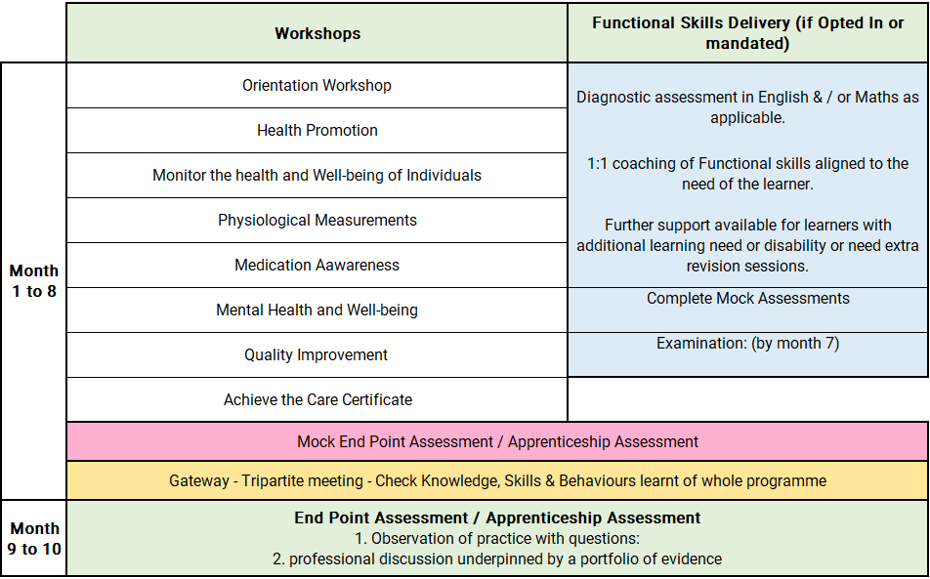
Healthcare Support Worker Level 2 Apprenticeship

Slide 4
Off-the-Job learning activities include:
Manual Handling
Statutory and Mandatory Training
Equality and Diversity
Conflict Resolution
Data Security and Protection
Health and Safety / Fire Safety
Infection Control
Oliver McGowan Training
Basic Life Support
CERNER training
Care Certificate training
Venepuncture — 1 day
Making Every Contact Count — 4 hours
Patient Safety Incident Response training
Freedom to Speak Up training
Shadowing nurses, MDT teams, critical care teams, qualified staff making referrals
Reading escalation and reporting policies
Observing appointment booking processes
Learning how to signpost individuals to services
Shadowing staff supporting people with: Dementia, mental health needs, learning disabilities
BEACH training — 1 day
Participating in quality improvement activities and audits
Attending team huddles
Reviewing Family and Friends feedback

Slide 5
Progression Opportunities
On successful completion, learners may progress to:
Level 3 Senior Healthcare Support Worker Apprenticeship
Progress into a specialist career pathway
Greater responsibility within the workplace
Enhanced clinical skills training
Competency-based clinical roles
Mentoring new support workers
Quality improvement projects
Champion roles, such as:
  Infection Prevention Champion
  Dementia Champion
  Falls Champion
  Nutrition and Hydration Champion
  Patient Safety Champion
  Safeguarding Champion

Slide 6
Off the Job Learning – Healthcare Support Worker
As part of this apprenticeship, participants complete a minimum of 278 hours of Off-the-Job learning over the duration of the programme.
Off-the-Job learning takes place during paid working hours and supports the development of the knowledge, skills and behaviours required within the Healthcare Support Worker apprenticeship.
Of the Job learning is essential, mandatory requirement of an apprenticeship to enable the learner and employer to see impactful learning that takes place.

Slide 7
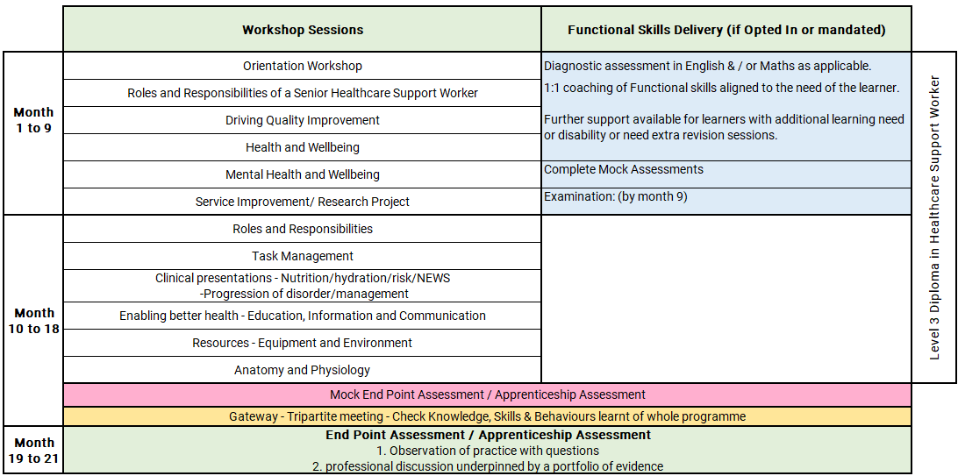
Senior Healthcare Support Worker Level 3 Apprenticeship
Allied Health Pathway
Notes:
Orientation Workshop
Introduction to programme structure, expectations and support.
Using online platforms and digital systems effectively.
Developing good study habits, time management and independent learning skills.
CORE MASTERCLASS SESSIONS
1. Roles and Responsibilities of a Senior Healthcare Support Worker
Duty of care, duty of candour, safeguarding, conflict management, incident reporting and British Values.
2. Driving Quality Improvement
Accountability, delegation, human factors, leadership, mentoring, clinical governance and service improvement.
3. Health and Wellbeing
Patient assessment, health promotion, physical wellbeing, recognising deterioration, pain management and holistic care.
4. Mental Health and Wellbeing
Mental health support, capacity, learning disabilities, dementia, legislation, safeguarding and person-centred approaches.
5. Study Skills and Service Improvement
Research methods, study skills, service improvement planning, reflective practice and evidence-based care.

Slide 8
Off-the-Job learning activities include:
Attending masterclasses and pathway workshops
Completing workbooks, assignments and independent study
Carrying out reflective learning activities
Supporting rehabilitation programmes
Assisting with patient assessments
Participating in care planning and review activities
Supporting health promotion interventions
Helping patients maximise independence and function
Working alongside Physiotherapists
Working alongside Occupational Therapists
Working alongside Speech and Language Therapists
Working alongside Dietitians
Participating in MDT meetings, referrals and discharge planning
Participating in audits and quality improvement activities
Reviewing patient pathways and outcomes
Contributing to service development activities
Reviewing AHP professional standards and guidance
Researching HCPC and professional body requirements
Completing CPD and e-learning activities
Exploring evidence-based practice and current research
Completing learning journal reflections

Slide 9
Progression Opportunities
On successful completion, learners may progress to:
Senior Allied Health Support Worker roles
Assistant Practitioner Apprenticeships
Nursing Associate Apprenticeships
Allied Health Professional Degree Apprenticeships
Physiotherapy, Occupational Therapy, Speech and Language Therapy or Dietetics degree programmes
Internal specialist rehabilitation and therapy support roles
Further healthcare career development opportunities

Slide 10
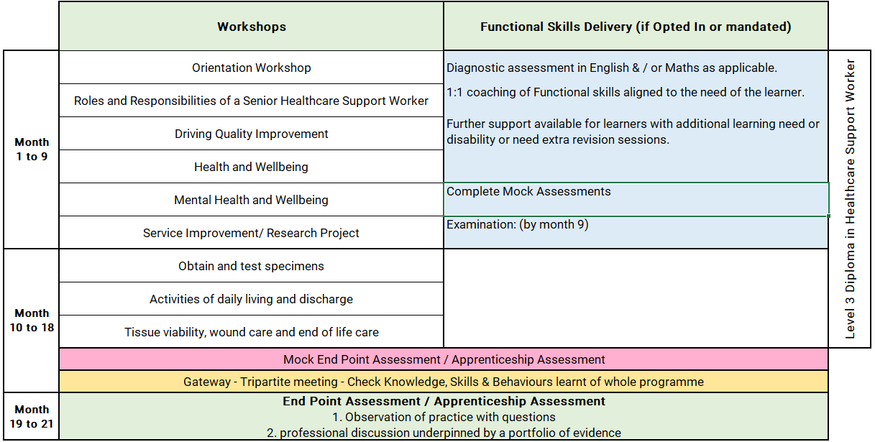
Senior Healthcare Support Worker Level 3 Apprenticeship
Adult Nursing Pathway
Notes:
Orientation Workshop
Introduction to programme structure, expectations and support.
Using online platforms and digital systems effectively.
Developing good study habits, time management and independent learning skills.
CORE MASTERCLASS SESSIONS
1. Roles and Responsibilities of a Senior Healthcare Support Worker
Duty of care, duty of candour, safeguarding, conflict management, incident reporting and British Values.
2. Driving Quality Improvement
Accountability, delegation, human factors, leadership, mentoring, clinical governance and service improvement.
3. Health and Wellbeing
Patient assessment, health promotion, physical wellbeing, recognising deterioration, pain management and holistic care.
4. Mental Health and Wellbeing
Mental health support, capacity, learning disabilities, dementia, legislation, safeguarding and person-centred approaches.
5. Study Skills and Service Improvement
Research methods, study skills, service improvement planning, reflective practice and evidence-based care.

Slide 11
Off-the-Job learning activities include:
Attending masterclasses
Completing workbooks and assignments
Carrying out independent research and study
Supporting patient assessments
Undertaking clinical procedures
Supporting activities of daily living
Obtaining and testing specimens
Supporting wound care and tissue viability
Participating in audits
Supporting quality improvement initiatives
Reflecting on patient care and outcomes
Shadowing healthcare professionals
Attending MDT meetings
Completing reflective practice activities
Developing portfolio evidence
Attending coaching sessions and progress reviews
Working alongside community nurses
Working alongside physiotherapists
Working alongside occupational therapists
Working alongside tissue viability teams
Working alongside discharge coordinators

Slide 12
Progression Opportunities
On successful completion, learners may progress to:
Senior Healthcare Support Worker roles
Nursing Associate Apprenticeships
Registered Nurse Degree Apprenticeships
Specialist healthcare support roles
Further clinical or leadership development opportunities

Slide 13
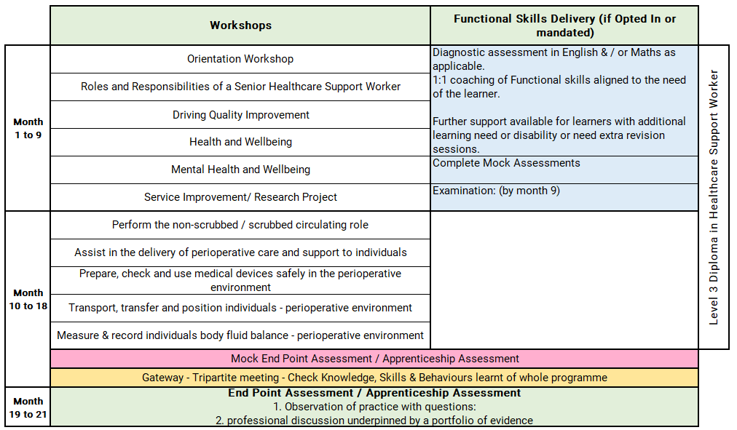
Senior Healthcare Support Worker Level 3 Apprenticeship
Theatres Pathway
Notes:
Orientation Workshop
Introduction to programme structure, expectations and support.
Using online platforms and digital systems effectively.
Developing good study habits, time management and independent learning skills.
CORE MASTERCLASS SESSIONS
1. Roles and Responsibilities of a Senior Healthcare Support Worker
Duty of care, duty of candour, safeguarding, conflict management, incident reporting and British Values.
2. Driving Quality Improvement
Accountability, delegation, human factors, leadership, mentoring, clinical governance and service improvement.
3. Health and Wellbeing
Patient assessment, health promotion, physical wellbeing, recognising deterioration, pain management and holistic care.
4. Mental Health and Wellbeing
Mental health support, capacity, learning disabilities, dementia, legislation, safeguarding and person-centred approaches.
5. Study Skills and Service Improvement
Research methods, study skills, service improvement planning, reflective practice and evidence-based care.

Slide 14
Off-the-Job learning activities include:
Attending masterclasses and pathway workshops
Completing workbooks and assignments
Carrying out independent research and study
Supporting perioperative care
Assisting with theatre preparation
Supporting infection prevention and control activities
Working with medical devices and equipment
Supporting patient transfers and positioning
Monitoring patient care and safety
Working alongside surgeons
Working with scrub practitioners
Learning from recovery/PACU teams
Supporting clinical governance activities
Reviewing patient safety processes
Contributing to service improvement initiatives
Reviewing theatre policies and procedures
Learning about human factors in healthcare
Completing e-learning and CPD activities
Exploring developments in perioperative practice
Completing learning journal reflections
Gathering workplace competency evidence
Taking part in career planning discussions
Shadowing theatre specialities, sterile services/CSSD , anaesthetics, radiography departments, recovery units, equipment managers
Working alongside multidisciplinary theatre teams

Slide 15
Progression Opportunities
On successful completion, learners may progress to:
Senior Theatre Support Worker roles
Theatre Support – Scrubbed Role pathway
Theatre Support – Recovery Role pathway
Nursing Associate Apprenticeships
Adult Nursing Apprenticeships
Operating Department Practitioner (ODP) Apprenticeships
University healthcare degree programmes
Specialist perioperative support roles

Slide 16
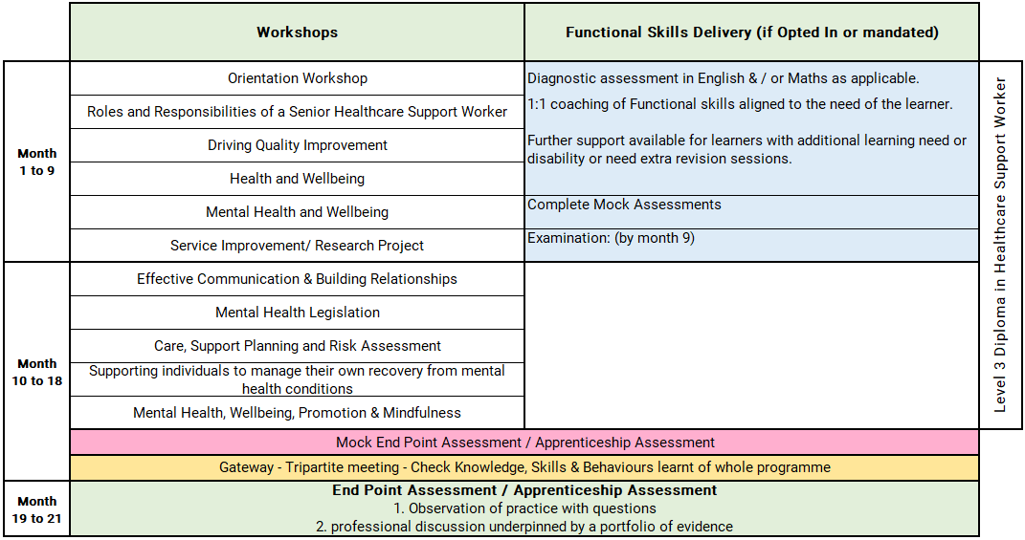
Senior Healthcare Support Worker Level 3 Apprenticeship
Mental Health Pathway
Notes:
Orientation Workshop
Introduction to programme structure, expectations and support.
Using online platforms and digital systems effectively.
Developing good study habits, time management and independent learning skills.
CORE MASTERCLASS SESSIONS
1. Roles and Responsibilities of a Senior Healthcare Support Worker
Duty of care, duty of candour, safeguarding, conflict management, incident reporting and British Values.
Accountability, delegation, human factors, leadership, mentoring, clinical governance and service improvement.
Patient assessment, health promotion, physical wellbeing, recognising deterioration, pain management and holistic care.
4. Mental Health and Wellbeing
Mental health support, capacity, learning disabilities, dementia, legislation, safeguarding and person-centred approaches.
5. Study Skills and Service Improvement
Research methods, study skills, service improvement planning, reflective practice and evidence-based care.

Slide 17
Off-the-Job learning activities include:
Attending masterclasses and pathway workshops
Completing workbooks and assignments
Carrying out independent research and study
Supporting recovery-focused care
Assisting with care planning activities
Supporting risk assessments
Participating in health and wellbeing activities
Supporting service users with therapeutic interventions
Working alongside nurses, psychologists and mental health practitioners
Shadowing occupational therapists
Working with community mental health teams
Participating in ward rounds and MDT meetings
Learning from safeguarding and discharge teams
Participating in audits
Supporting service improvement initiatives
Reviewing care plans and patient outcomes
Contributing to quality assurance activities
Reviewing mental health legislation and guidance
Developing knowledge of recovery-focused practice
Completing CPD and e-learning activities
Researching mental health conditions and interventions

Slide 18
Progression Opportunities
On successful completion, learners may progress to:
Senior Mental Health Support Worker roles
Community Mental Health Worker roles
Therapy Support Worker positions
Nursing Associate Apprenticeships
Registered Nursing Degree Apprenticeships
Mental Health Nursing programmes
Psychology, Social Work or other health-related degree pathways
Further specialist training within mental health services

Slide 19
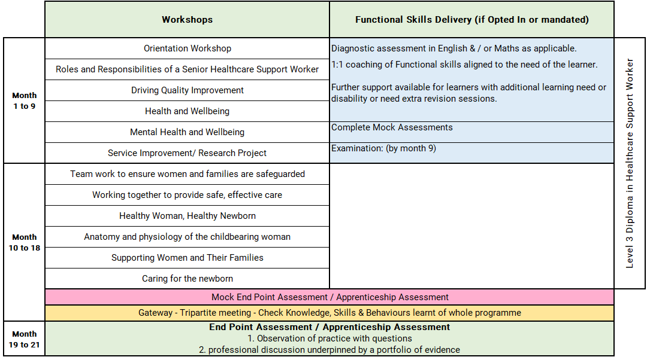
Senior Healthcare Support Worker Level 3 Apprenticeship
Maternity Pathway
Notes:
Orientation Workshop
Introduction to programme structure, expectations and support.
Using online platforms and digital systems effectively.
Developing good study habits, time management and independent learning skills.
CORE MASTERCLASS SESSIONS
1. Roles and Responsibilities of a Senior Healthcare Support Worker
Duty of care, duty of candour, safeguarding, conflict management, incident reporting and British Values.
2. Driving Quality Improvement
Accountability, delegation, human factors, leadership, mentoring, clinical governance and service improvement.
3. Health and Wellbeing
Patient assessment, health promotion, physical wellbeing, recognising deterioration, pain management and holistic care.
4. Mental Health and Wellbeing
Mental health support, capacity, learning disabilities, dementia, legislation, safeguarding and person-centred approaches.
5. Study Skills and Service Improvement
Research methods, study skills, service improvement planning, reflective practice and evidence-based care.

Slide 20
Off-the-Job learning activities include:
Attending masterclasses and pathway workshops
Completing workbooks and assignments
Carrying out independent research and study
Supporting antenatal and postnatal care
Assisting with health promotion activities
Supporting blood sampling procedures
Participating in newborn observations and care
Supporting infant feeding initiatives
Assisting with discharge and ongoing care planning
Working alongside midwives and maternity teams
Shadowing safeguarding professionals
Working with infant feeding specialists
Participating in multidisciplinary discussions and care planning
Participating in audits
Supporting service improvement initiatives
Reviewing patient experience and outcomes
Reviewing national guidance and maternity policies
Completing e-learning and CPD activities
Researching best practice in maternity care

Slide 21
Progression Opportunities
On successful completion, learners may progress to:
Senior Maternity Support Worker roles
Nursing Associate Apprenticeships
Midwifery Degree Apprenticeships
Registered Midwifery programmes
Registered Nursing pathways
Specialist maternity support roles
Further clinical or leadership development opportunities

Slide 22
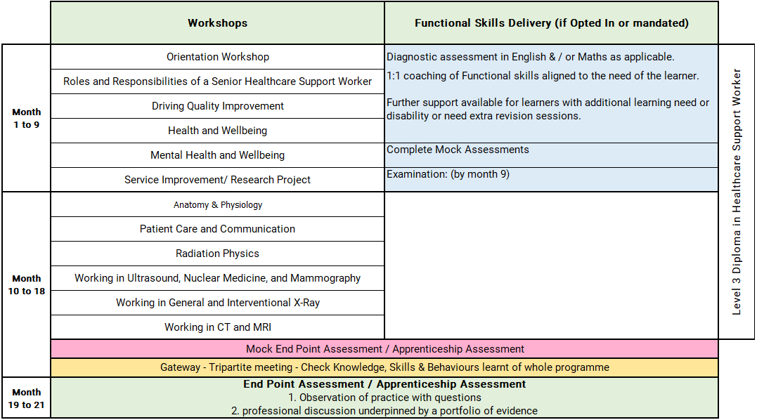
Senior Healthcare Support Worker Level 3 Apprenticeship
Diagnostic Imaging Pathway
Notes:
Orientation Workshop
Introduction to programme structure, expectations and support.
Using online platforms and digital systems effectively.
Developing good study habits, time management and independent learning skills.
CORE MASTERCLASS SESSIONS
1. Roles and Responsibilities of a Senior Healthcare Support Worker
Duty of care, duty of candour, safeguarding, conflict management, incident reporting and British Values.
2. Driving Quality Improvement
Accountability, delegation, human factors, leadership, mentoring, clinical governance and service improvement.
3. Health and Wellbeing
Patient assessment, health promotion, physical wellbeing, recognising deterioration, pain management and holistic care.
4. Mental Health and Wellbeing
Mental health support, capacity, learning disabilities, dementia, legislation, safeguarding and person-centred approaches.
5. Study Skills and Service Improvement
Research methods, study skills, service improvement planning, reflective practice and evidence-based care.

Slide 23
Off-the-Job learning activities include:
Attending masterclasses and pathway workshops
Completing workbooks and assignments
Carrying out independent research and study
Supporting patient preparation and aftercare
Assisting with imaging procedures
Supporting patient identification and consent processes
Promoting patient safety and dignity
Assisting with infection prevention and control activities
Working alongside radiographers and imaging teams
Shadowing MDT coordinators
Working with safeguarding teams
Participating in multidisciplinary meetings and discussions
Supporting clinical governance activities
Participating in audits
Contributing to service improvement initiatives
Reviewing quality and risk management processes
Reviewing imaging legislation and national guidance
Developing knowledge of radiation safety and protection
Completing CPD and e-learning activities
Researching advances in diagnostic imaging
Completing learning journal reflections

Slide 24
Progression Opportunities
On successful completion, learners may progress to:
Senior Imaging Support Worker roles
Level 4 Assistant Practitioner Apprenticeships
Diagnostic Radiography Degree Apprenticeships
Healthcare Science pathways
Further diagnostic imaging specialisms
Other healthcare professional training routes

Slide 25
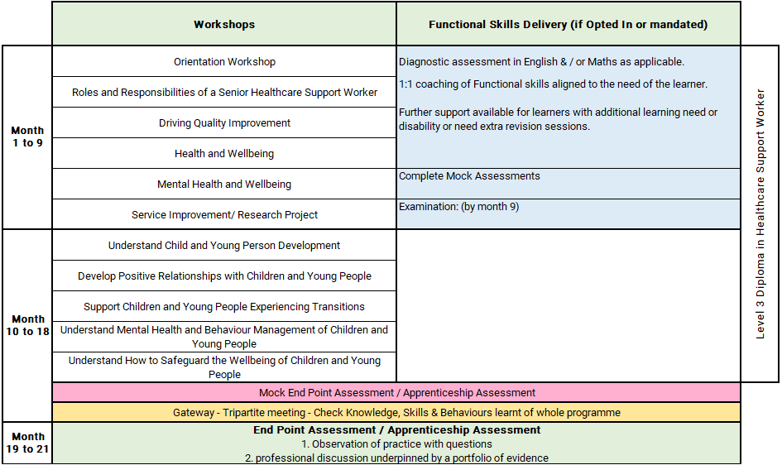
Senior Healthcare Support Worker Level 3 Apprenticeship
Children and Young People Pathway
Notes:
Orientation Workshop
Introduction to programme structure, expectations and support.
Using online platforms and digital systems effectively.
Developing good study habits, time management and independent learning skills.
CORE MASTERCLASS SESSIONS
1. Roles and Responsibilities of a Senior Healthcare Support Worker
Duty of care, duty of candour, safeguarding, conflict management, incident reporting and British Values.
2. Driving Quality Improvement
Accountability, delegation, human factors, leadership, mentoring, clinical governance and service improvement.
3. Health and Wellbeing
Patient assessment, health promotion, physical wellbeing, recognising deterioration, pain management and holistic care.
4. Mental Health and Wellbeing
Mental health support, capacity, learning disabilities, dementia, legislation, safeguarding and person-centred approaches.
5. Study Skills and Service Improvement
Research methods, study skills, service improvement planning, reflective practice and evidence-based care.
Child and Young Person Development
Child development from birth to 19
Developmental milestones
Early intervention
Developmental assessment tools
Multi-agency working
Developing Positive Relationships
Partnership working
Communication with children and families
Professional boundaries
Child-centred approaches
Building trust and rapport
Supporting Transitions
Types of transitions
Emotional wellbeing
Supporting resilience
Transition planning
Family involvement
Mental Health and Behaviour Management
Children's mental health
Behaviour support strategies
Positive mental wellbeing
Observation and supervision
Reducing stigma and discrimination
Safeguarding Children and Young People
Child protection
Safeguarding legislation
Information sharing
Partnership working
Professional responsibilities
Online safety and e-safety

Slide 26
Off-the-Job learning activities include:
Attending interactive workshops
Carrying out independent research
Completing reflective practice activities
Developing portfolio evidence
Participating in professional discussions
Shadowing experienced practitioners
Working within multidisciplinary teams
Supporting service improvement activities
Taking part in leadership and mentoring opportunities
Supporting clinical governance activities
Participating in developmental assessment activities
Completing safeguarding training
Researching child development
Participating in mental health awareness activities
Supporting family-centred care activities
Supporting transition planning
Shadowing health visiting teams
Shadowing school nursing teams
Shadowing speech and language therapy teams
Shadowing play therapy services
Shadowing community paediatrics teams
Shadowing children’s safeguarding services
Shadowing CAMHS services
Shadowing hospital teaching services

Slide 27
Progression Opportunities
On successful completion, learners may progress to:
Senior Imaging Support Worker roles
Level 4 Assistant Practitioner Apprenticeships
Diagnostic Radiography Degree Apprenticeships
Healthcare Science pathways
Further diagnostic imaging specialisms
Other healthcare professional training routes

Slide 28
Off the Job Learning – Senior Healthcare Support Worker
As part of this apprenticeship, participants complete a minimum of 438 hours of Off-the-Job learning over the duration of the programme.
Off-the-Job learning takes place during paid working hours and supports the development of the knowledge, skills and behaviours required within the Senior Healthcare Support Worker apprenticeship.
Of the Job learning is essential, mandatory requirement of an apprenticeship to enable the learner and employer to see impactful learning that takes place.

Slide 29
Apprenticeships: What You Need to Know
An apprenticeship is a work-based learning programme
Developed by employers from the sector
Funded through the apprenticeship Levy
Suitable for new entrants and existing staff developing their careers.
An apprenticeship consists of:
An apprenticeship is a work-based learning programme
Knowledge of the areas involved in the staff's role at the appropriate level
Skills the learner is expected to demonstrate competently
An option to upskilling in maths and English and achievement of functional skills (if not mandated)
Achievement of Diploma or other requirement subject to the needs of the apprenticeship standard

Slide 30
The Apprenticeship Journey
Application
On
Programme
Assessment
Gateway
EPA / Apprenticeship Assessment
(example)
Completion
Observation in practice
Information
Off the job training
Preparation for assessment
Achievement
Application & eligibility check
Multiple choice exam
Standard/Diploma
/Other
Evidence of programme achievement 100%
Certification
Assessments & induction
Reflective journal and interview
English & maths opt in
Ready for EPA/ Apprenticeship Assessment
Progression

Slide 31







Apprenticeship Support
Learning Support Assistant
Skills & Development Coach
Employer including: Line Manager /Mentor
Functional Skills Tutor
Supported employment service Job Coach
Apprentice / Learner
Apprenticeship Assessment Organisation

Slide 32
Reasonable adjustments to learning and assessment
Reasonable adjustments can be made for example:
Extra time allowance
Assistive technology
Alternative assessment methods
British sign language interpreter
Timed rest breaks
121 support
Increased support.

Slide 33
Understanding Functional Skills
Notes:
Apprentices with an undiagnosed learning difficulty or disability may be able to access this flexibility by completing a detailed assessment with our specialist coach.

Slide 34
Dedicated Learning Time
Teaching & Learning Reviews
⏱ 2 hours (every 4–6 weeks)
• In person or online
• Learner meets with Coach
• Feedback shared with Line Manager / Workplace Mentor
Online Workshops (MS Teams)
📅 Approx. monthly
• Full‑day workshops
• Aligned to the apprenticeship standard
• Dates confirmed at programme start
10 –12 Week Progress Reviews
⏱ 90 minutes
• Three‑way review: Coach, Learner, Line Manager / Mentor
• Review progress, impact of learning and next steps
Independent Learning /
Study Time
⏱ Weekly commitment
• Minimum half a day per week
• 1–2 hours focused work‑based learning
Notes:
Responsibilities
The Apprentice
Complete work meeting targets set
Attend any training sessions made available
Communicate clearly and regularly with Tutor
Commence Functional Skills from the beginning of their programme if required to complete
Complete and record off-the-Job activity every month
Independent learning / time for study – reading, watching developmental videos, research tasks and projects
Line Manager/Mentor
Support development of the learner, giving opportunity to practice new skills attained in the workplace
Allow the learner to attend all agreed Tutor sessions and allow protected time for reflection and written work
Support with off-the-job learning identification and recording
Attend progress reviews
In work learning opportunities – Shadowing, stepping up, coaching, mentoring
Dynamic Training
Create an individual learning plan
Identify any recognition of prior learning
Provide quality training, support and assessment
Provide regular feedback and development opportunities
Adapt delivery and assessment to meet individual needs where applicable

Slide 35






E-learning Tools
The tools learners use to support achievement of their apprenticeship programme

Slide 36

UCAS Points
Individuals completing apprenticeships may be awarded up to 112 UCAS points, depending on the length of their apprenticeship.
Apprentices must pass their end-point assessment / Apprenticeship Assessment to utilise these points for university applications (including higher, degree level apprenticeship programmes)
Notes:
Length is duration planned not how long the programme takes to achieve. i.e. if a learner achieves earlier they get the planned duration UCAs tariff points.

Slide 37
Employer Grants & Incentives
£1,000 — Young Apprentice Incentive
Employers can receive £1,000 for taking on an apprentice aged 16 to 18 years old, or aged 19 to 24 years old with an Education, Health and Care Plan, or who is a care leaver.
Employer eligibility: All sizes of employer
Availability: Available now
£2,000 — Non-Levy Jobs Grant
From October 2026, employers that do not pay the apprenticeship levy could receive up to £2,000 for hiring an apprentice aged 16 to 24, and new employees within the previous 3 months.
Employer eligibility: Only for non-levy employers
Availability: Available from October 2026
£3,000 — Youth Jobs Grant
Businesses can receive £3,000 for hiring an individual aged 18 to 24 who has been receiving Universal Credit and looking for work for six months or more.
Employer eligibility: All sizes of employer
Availability: Available now
£2,000 — Foundation Apprenticeship Incentive
Employers offering Foundation Apprenticeships to young people aged 16 to 21, or eligible 22 to 24 year olds, can receive up to £2,000.
Payments support progression to a further apprenticeship.
Employer eligibility: All sizes of employer
Availability: Available now

Slide 38
Additional Incentives
National Insurance Contributions
Employers do not pay National Insurance Contributions for apprentices aged under 25 years, or for any employee aged 21 or below, if salary is below £50,270.
Rate referenced: 2025/26 rate
Funding for Under 25s
Non-levy employers do not pay training costs for apprentices aged under 25.
For those aged 25+, the cost is 5%, or zero if using a levy transfer.
Care Leavers’ Bursary
Eligible apprentices aged 18 to 24 can receive an additional £3,000 from government, in addition to their salary.
This payment is tax free.
Employers may be able to access multiple incentives for the same young person where eligibility criteria are met.

Slide 39
Questions for Reflection
How would this benefit me?
Would I be able to commit?
What other commitments do I currently have?
Would my department support this?
What would I need from my employer to support me?

Slide 40
Next Steps
Make an informed decision if the apprenticeship programme is right for you?
If yes!
Follow your companies expression of Interest process to start the enrolment process or
Email us and we will contact your employer direct – ask.dynamic@dynamictraining.org.uk
Find out more about the programmes via our website www.dynamictraining.org.uk
Speak to one our team to answer your questions via email ask.dynamic@dynamictraining.org.uk or call 0208 607 7850

