Slide 1

Healthcare Science Assistant Level 2 Apprenticeships.

Slide 2
Who are Dynamic Training
Established in 2007
Centres in Uxbridge and Hartlepool
Delivering
Apprenticeships
&
Bespoke Training Solutions
Supporting circa 500 learners on a variety of programmes at any one time
Over 80 NHS Trusts choose Dynamic Training with their ongoing Learning & Development Needs
Matrix Accredited.
A Skills for Care Endorsed provider.
A disability confident employer
Part of Calder Holding BV
13 companies with 1000+ employees in the UK and the Netherlands.
Retained our Ofsted “good” inspection grade in June 2025

Slide 3
Off the Job Learning
As part of this apprenticeship, participants complete a minimum of 326 hours of Off-the-Job learning over the duration of the programme.
Off-the-Job learning takes place during paid working hours and supports the development of the knowledge, skills and behaviours required within the Healthcare Science Assistant apprenticeship.
Of the Job learning is essential, mandatory requirement of an apprenticeship to enable the learner and employer to see impactful learning that takes place.

Slide 4
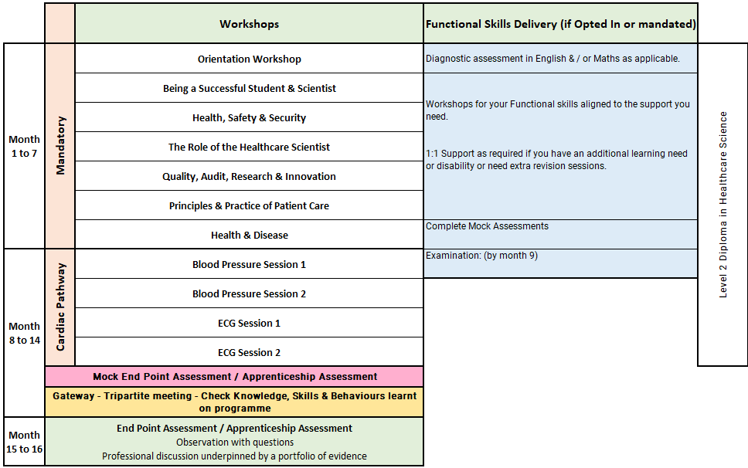
Healthcare Science Assistant Level 2: Cardiac Pathway
Notes:
Orientation Workshop
Introduction to programme structure, expectations and support.
Using online platforms and digital systems effectively.
Developing good study habits, time management and independent learning skills.
Core Session 2 – Being a Successful Student and Scientist
This session focuses on professional development as a healthcare scientist. It covers the importance of appraisals, how to prepare for them, and understanding the NHS Leadership Model. Participants will also explore their roles within healthcare, potential career paths, and the significance of reflective practice for continuous learning.
Core Session 3 – Health, Safety and Security
Participants will learn about health and safety responsibilities in the workplace, including their own duties and those of others. The session also covers responding to accidents, safe handling of equipment and hazardous materials, promoting fire safety, and understanding risk assessment principles.
Core Session 4 – The Role of the Healthcare Scientist
This session delves into the diverse roles within healthcare science, emphasizing the importance of technical documentation and patient confidentiality. Attendees will also learn strategies for effective communication and collaboration within healthcare teams.
Core Session 5 – Quality, Audit, Research and Innovation
This session introduces key legislation, policies, and procedures related to workplace quality standards. It explains audit principles, the concept of competence, and the use of quality resources. Participants will also explore how research and innovation drive advancements in healthcare.
Core Session 6 – Principles and Practice of Patient Care
Participants will gain an understanding of the NHS Core Values and key patient care concepts. The session emphasizes adherence to relevant codes of conduct, the rights of both patients and healthcare professionals, and strategies for promoting mental health and well-being.
Core Session 7 – Health and Disease
This session examines the definitions of health and disease, the causes and transmission of infections, and factors that influence health. Participants will explore common causes of disease, methods for prevention, and ways to support patients in managing their health. The role of national public health bodies is also discussed.
Months 6–14 Specialist Units: Session Synopsis
Unit 21: Introduction to Anatomy and Physiology
Introduces key terms: anatomy and physiology
Explains how body structure links to body function
Covers body organisation from cells to full body systems
Identifies major body systems and common related diseases
Explores how disease affects patients and families
Introduces diagnostic tests across scientific disciplines
Unit 24: Cardiovascular, Lymphatic and Respiratory Systems
Covers the structure and function of blood, blood vessels and the heart
Explores the lymphatic and immune systems
Explains the respiratory system and gas exchange
Links normal function to common disorders
Introduces tests used to diagnose and manage related conditions
Unit 72: Measuring Blood Pressure Using an Automatic Machine
Explains the purpose of blood pressure measurement
Introduces automatic BP equipment
Covers preparation of the patient and clinical setting
Develops skills in taking resting BP readings
Includes accurate recording and documentation
Unit 77: Fitting a 24-Hour Ambulatory Blood Pressure Monitor
Covers why 24-hour BP monitoring is used
Includes preparation of equipment and environment
Follows local SOPs for safe setup
Focuses on explaining the procedure clearly to patients
Develops skills in fitting and managing ABPM
Unit 78: Manual Blood Pressure Measurement
Explains the principles of manual BP measurement
Covers blood pressure changes and natural variability
Includes preparation of patient and equipment
Develops skills in taking and documenting manual BP
Introduces quality assurance for accurate readings
Unit 73: Performing Routine Electrocardiography in Adults
Covers heart structure, function and electrical activity
Explains how this relates to a normal ECG
Develops skills in recording a 12-lead ECG
Focuses on patient communication and safe practice
Includes checking ECG quality
Introduces recognition of life-threatening arrhythmias
Unit 75: Setting Up a Cardiac Monitor
Explains the heart’s normal conduction system
Covers the purpose of cardiac monitoring
Develops skills in preparing and setting up monitors
Includes checking recording quality and observation arrangements
Focuses on recognising and escalating abnormal rhythms
Unit 76: Fitting a 24-Hour Ambulatory ECG Monitor
Covers reasons for 24-hour ECG monitoring
Introduces common related medications
Includes preparation of equipment and patient
Focuses on clear communication with patients and staff
Develops skills in fitting and managing ambulatory ECG monitoring

Slide 5
Cardiac: Off-the-Job learning activities include:
Practice reflections through the reflective diary task and find reflective models that feel natural to write with.
Speak with the local health and safety officer for information on relevant policies and guidelines.
Complete extracurricular reading on subjects such as hazardous material handling and management.
Research the healthcare science divisions and reflect on the roles and responsibilities of science in patient care.
Study local document control procedures and discuss with senior staff how policies are developed and published.
Participate in the audit procedure with guidance from trained staff to develop an understanding of audits.
Shadow a staff member performing quality procedures / Sit in on a quality-based meeting.
Research various diseases and infection routes.
Shadow the infection control team for half a day.
Research local hospital policies and procedures for high-risk and infectious diseases from patient admission to ward decontamination after discharge.
Pathway Specific
Shadowing in pathology, respiratory, or cardiac departments
Observing non-patient-contact diagnostic procedures (e.g., haematology analyser)
Observing or assisting with ECG recording (under supervision)
Viewing or performing spirometry or pulse oximetry measurements
Review anonymised case studies as part of MDT discussions
Practical BP training with simulated patients
Shadowing hypertension clinics
Practice on peers using different devices
Observations and discussions with senior physiologists
ABPM fitting practice
Practice troubleshooting poor-quality traces using SCST guidance
Simulated ECG recordings and peer assessments

Slide 6
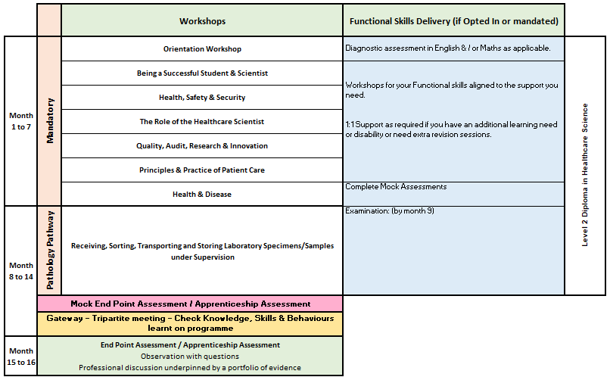
Healthcare Science Assistant Level 2: Pathology Pathway
Notes:
Orientation Workshop
Introduction to programme structure, expectations and support.
Using online platforms and digital systems effectively.
Developing good study habits, time management and independent learning skills.
Core Session 2 – Being a Successful Student and Scientist
This session focuses on professional development as a healthcare scientist. It covers the importance of appraisals, how to prepare for them, and understanding the NHS Leadership Model. Participants will also explore their roles within healthcare, potential career paths, and the significance of reflective practice for continuous learning.
Core Session 3 – Health, Safety and Security
Participants will learn about health and safety responsibilities in the workplace, including their own duties and those of others. The session also covers responding to accidents, safe handling of equipment and hazardous materials, promoting fire safety, and understanding risk assessment principles.
Core Session 4 – The Role of the Healthcare Scientist
This session delves into the diverse roles within healthcare science, emphasizing the importance of technical documentation and patient confidentiality. Attendees will also learn strategies for effective communication and collaboration within healthcare teams.
Core Session 5 – Quality, Audit, Research and Innovation
This session introduces key legislation, policies, and procedures related to workplace quality standards. It explains audit principles, the concept of competence, and the use of quality resources. Participants will also explore how research and innovation drive advancements in healthcare.
Core Session 6 – Principles and Practice of Patient Care
Participants will gain an understanding of the NHS Core Values and key patient care concepts. The session emphasizes adherence to relevant codes of conduct, the rights of both patients and healthcare professionals, and strategies for promoting mental health and well-being.
Core Session 7 – Health and Disease
This session examines the definitions of health and disease, the causes and transmission of infections, and factors that influence health. Participants will explore common causes of disease, methods for prevention, and ways to support patients in managing their health. The role of national public health bodies is also discussed.
Unit 64: Receiving, Sorting, Transporting and Storing Laboratory Specimens/Samples under Supervision
Develops knowledge and skills in handling laboratory specimens safely
Covers receiving and sorting specimens under supervision
Explains correct transport and storage procedures
Introduces laboratory processes for managing samples
Covers how to identify and manage problem samples, including:
insufficient samples
mislabelled samples
high-risk specimens
Emphasises correct health and safety procedures during laboratory tasks

Slide 7
Pathology: Off-the-Job learning activities include:
Practice reflections through the reflective diary task and find reflective models that feel natural to write with.
Speak with the local health and safety officer for information on relevant policies and guidelines.
Complete extracurricular reading on subjects such as hazardous material handling and management.
Research the healthcare science divisions and reflect on the roles and responsibilities of science in patient care.
Study local document control procedures and discuss with senior staff how policies are developed and published.
Participate in the audit procedure with guidance from trained staff to develop an understanding of audits.
Shadow a staff member performing quality procedures / Sit in on a quality-based meeting.
Research various diseases and infection routes.
Shadow the infection control team for half a day.
Research local hospital policies and procedures for high-risk and infectious diseases from patient admission to ward decontamination after discharge.
Shadow a staff member performing quality procedures / Sit in on a quality-based meeting.
Research various diseases and infection routes.
Shadow the infection control team for half a day.
Research local hospital policies and procedures for high-risk and infectious diseases from patient admission to ward decontamination after discharge.
Pathway specific
Competencies in specimen booking in, sending samples externally, stock recording and other relevant activities.
Signed documents including maintenance/daily checklists
Audit trails on specimens

Slide 8
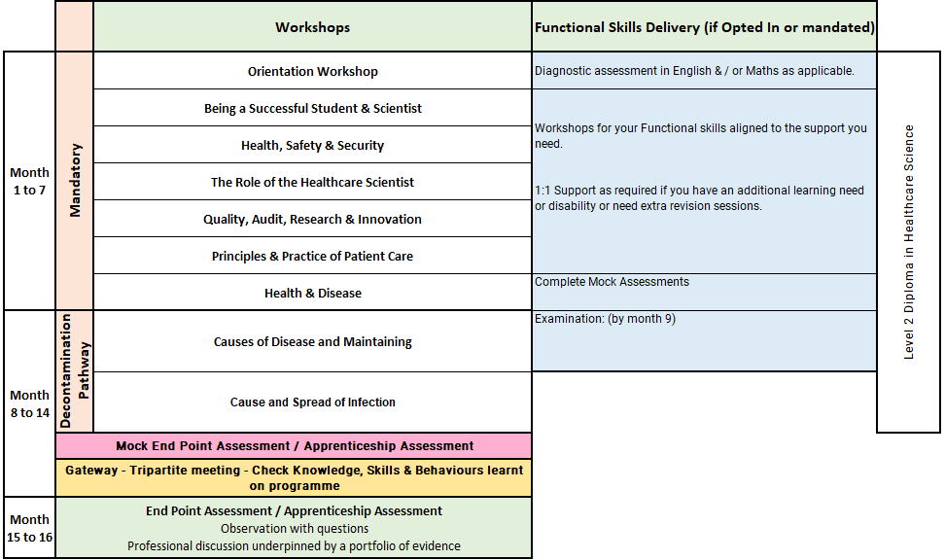
Healthcare Science Assistant Level 2: Decontamination
Notes:
Orientation Workshop
Introduction to programme structure, expectations and support.
Using online platforms and digital systems effectively.
Developing good study habits, time management and independent learning skills.
Core Session 2 – Being a Successful Student and Scientist
This session focuses on professional development as a healthcare scientist. It covers the importance of appraisals, how to prepare for them, and understanding the NHS Leadership Model. Participants will also explore their roles within healthcare, potential career paths, and the significance of reflective practice for continuous learning.
Core Session 3 – Health, Safety and Security
Participants will learn about health and safety responsibilities in the workplace, including their own duties and those of others. The session also covers responding to accidents, safe handling of equipment and hazardous materials, promoting fire safety, and understanding risk assessment principles.
Core Session 4 – The Role of the Healthcare Scientist
This session delves into the diverse roles within healthcare science, emphasizing the importance of technical documentation and patient confidentiality. Attendees will also learn strategies for effective communication and collaboration within healthcare teams.
Core Session 5 – Quality, Audit, Research and Innovation
This session introduces key legislation, policies, and procedures related to workplace quality standards. It explains audit principles, the concept of competence, and the use of quality resources. Participants will also explore how research and innovation drive advancements in healthcare.
Core Session 6 – Principles and Practice of Patient Care
Participants will gain an understanding of the NHS Core Values and key patient care concepts. The session emphasizes adherence to relevant codes of conduct, the rights of both patients and healthcare professionals, and strategies for promoting mental health and well-being.
Core Session 7 – Health and Disease
This session examines the definitions of health and disease, the causes and transmission of infections, and factors that influence health. Participants will explore common causes of disease, methods for prevention, and ways to support patients in managing their health. The role of national public health bodies is also discussed.
Decom
Units 11 & 12: Causes of Disease, Maintaining Health, and Cause and Spread of Infection
Delivered as a combined online unit
Explores definitions of health and disease
Covers different causes of disease and how to maintain health and wellbeing
Introduces key micro-organisms, including:
bacteria
viruses
fungi
parasites
Explains how infections spread and the main routes of transmission
Covers conditions needed for micro-organisms to grow
Discusses departmental infection control procedures
Explores how to reduce the risk of infection outbreaks
Introduces the role of Public Health agencies
Includes group activities, self-study and workbook completion
Units 96, 97 & 98: Decontamination and Sterilisation Technical Units
Delivered externally by Eastwood Park
Focuses on working safely and effectively in a decontamination setting
Covers reusable medical device processes, including:
receiving
cleaning
disinfection
inspection
function testing
assembly
packaging
sterilisation
Develops knowledge, skills and professional attitudes for decontamination work
Primarily assessed through work-based activities
Learners gather evidence of competence, such as:
competency records
maintenance logs
daily checklists
witness testimonies
further training records
Supports safe practice within controlled or clean environments

Slide 9
Decontamination: Off-the-Job learning activities include:
Practice reflections through the reflective diary task and find reflective models that feel natural to write with.
Speak with the local health and safety officer for information on relevant policies and guidelines.
Complete extracurricular reading on subjects such as hazardous material handling and management.
Research the healthcare science divisions and reflect on the roles and responsibilities of science in patient care.
Study local document control procedures and discuss with senior staff how policies are developed and published.
Participate in the audit procedure with guidance from trained staff to develop an understanding of audits.
Shadow a staff member performing quality procedures / Sit in on a quality-based meeting.
Research various diseases and infection routes.
Shadow the infection control team for half a day.
Research local hospital policies and procedures for high-risk and infectious diseases from patient admission to ward decontamination after discharge.
Shadow a staff member performing quality procedures / Sit in on a quality-based meeting.
Research various diseases and infection routes.
Shadow the infection control team for half a day.
Research local hospital policies and procedures for high-risk and infectious diseases from patient admission to ward decontamination after discharge.
Pathway specific
Competencies in specimen booking in, sending samples externally, stock recording and other relevant activities.
Signed documents including maintenance/daily checklists
Audit trails on specimens

Slide 10
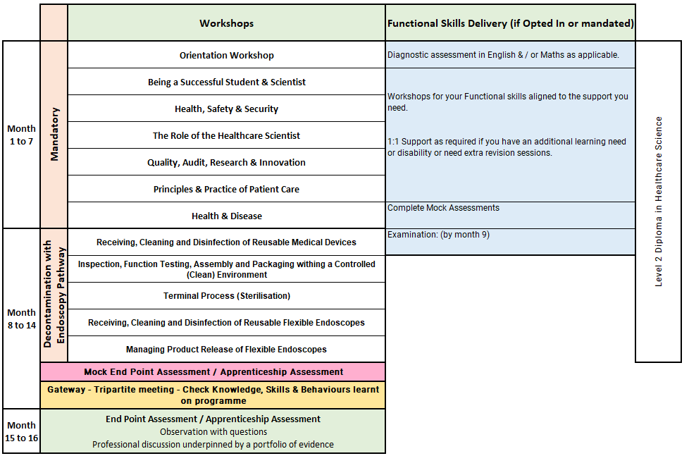
Healthcare Science Assistant Level 2: Decontamination with Endoscopy
Notes:
Orientation Workshop
Introduction to programme structure, expectations and support.
Using online platforms and digital systems effectively.
Developing good study habits, time management and independent learning skills.
Core Session 2 – Being a Successful Student and Scientist
This session focuses on professional development as a healthcare scientist. It covers the importance of appraisals, how to prepare for them, and understanding the NHS Leadership Model. Participants will also explore their roles within healthcare, potential career paths, and the significance of reflective practice for continuous learning.
Core Session 3 – Health, Safety and Security
Participants will learn about health and safety responsibilities in the workplace, including their own duties and those of others. The session also covers responding to accidents, safe handling of equipment and hazardous materials, promoting fire safety, and understanding risk assessment principles.
Core Session 4 – The Role of the Healthcare Scientist
This session delves into the diverse roles within healthcare science, emphasizing the importance of technical documentation and patient confidentiality. Attendees will also learn strategies for effective communication and collaboration within healthcare teams.
Core Session 5 – Quality, Audit, Research and Innovation
This session introduces key legislation, policies, and procedures related to workplace quality standards. It explains audit principles, the concept of competence, and the use of quality resources. Participants will also explore how research and innovation drive advancements in healthcare.
Core Session 6 – Principles and Practice of Patient Care
Participants will gain an understanding of the NHS Core Values and key patient care concepts. The session emphasizes adherence to relevant codes of conduct, the rights of both patients and healthcare professionals, and strategies for promoting mental health and well-being.
Core Session 7 – Health and Disease
This session examines the definitions of health and disease, the causes and transmission of infections, and factors that influence health. Participants will explore common causes of disease, methods for prevention, and ways to support patients in managing their health. The role of national public health bodies is also discussed.
Units 96–100: Decontamination and Endoscopy Technical Units
Delivered externally by Eastwood Park
Duration: 5 months
Develops the knowledge, skills and professional attitudes needed to work in a decontamination setting
Focuses on safe handling and processing of reusable medical devices and flexible endoscopes
Covers key decontamination processes, including:
receiving
cleaning
disinfection
inspection
function testing
assembly
packaging
sterilisation
product release of flexible endoscopes
Includes work within controlled or clean environments
Primarily assessed through work-based activities
Learners gather evidence of competence, such as:
competency records
maintenance logs
daily checklists
witness testimonies
further departmental training records
Supports safe, effective and compliant practice in decontamination services

Slide 11
Decontamination with Endoscopy - Off-the-Job learning activities include:
Practice reflections through the reflective diary task and find reflective models that feel natural to write with.
Speak with the local health and safety officer for information on relevant policies and guidelines.
Complete extracurricular reading on subjects such as hazardous material handling and management.
Research the healthcare science divisions and reflect on the roles and responsibilities of science in patient care.
Study local document control procedures and discuss with senior staff how policies are developed and published.
Participate in the audit procedure with guidance from trained staff to develop an understanding of audits.
Shadow a staff member performing quality procedures / Sit in on a quality-based meeting.
Research various diseases and infection routes.
Shadow the infection control team for half a day.
Research local hospital policies and procedures for high-risk and infectious diseases from patient admission to ward decontamination after discharge.
Understanding the wider patient journey by attending a Multi-Disciplinary Team Meeting (MDM/MDT) where a patient’s pathway is being discussed using diagnostic tests.
Any opportunities to see any procedures either in Theatres or Endoscopy where scopes have been used.
Any Trust/Organisational Quality Meetings where audit and data is being discussed, particularly anything in relation to Infection Control and Hospital Acquired Infections (HAI’s).
Attend a Comorbidity Meeting where any unexpected or unexplained patient deaths are discussed. Root cause analysis would be included in these sessions

Slide 12
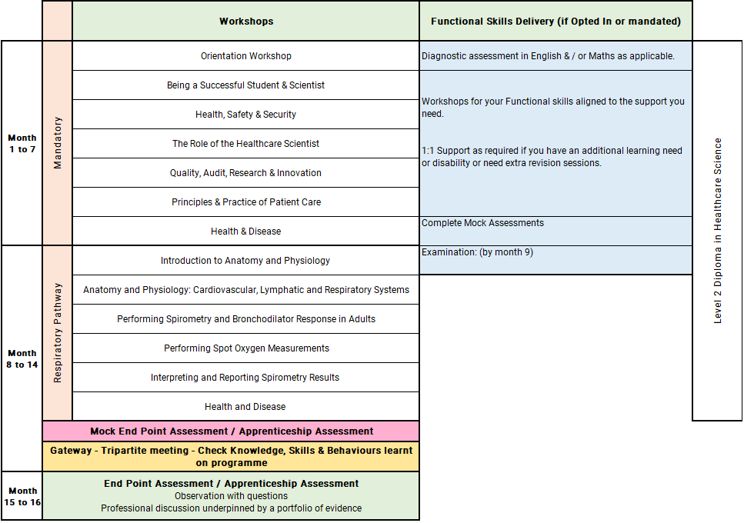
Healthcare Science Assistant Level 2: Respiratory
Notes:
Orientation Workshop
Introduction to programme structure, expectations and support.
Using online platforms and digital systems effectively.
Developing good study habits, time management and independent learning skills.
Core Session 2 – Being a Successful Student and Scientist
This session focuses on professional development as a healthcare scientist. It covers the importance of appraisals, how to prepare for them, and understanding the NHS Leadership Model. Participants will also explore their roles within healthcare, potential career paths, and the significance of reflective practice for continuous learning.
Core Session 3 – Health, Safety and Security
Participants will learn about health and safety responsibilities in the workplace, including their own duties and those of others. The session also covers responding to accidents, safe handling of equipment and hazardous materials, promoting fire safety, and understanding risk assessment principles.
Core Session 4 – The Role of the Healthcare Scientist
This session delves into the diverse roles within healthcare science, emphasizing the importance of technical documentation and patient confidentiality. Attendees will also learn strategies for effective communication and collaboration within healthcare teams.
Core Session 5 – Quality, Audit, Research and Innovation
This session introduces key legislation, policies, and procedures related to workplace quality standards. It explains audit principles, the concept of competence, and the use of quality resources. Participants will also explore how research and innovation drive advancements in healthcare.
Core Session 6 – Principles and Practice of Patient Care
Participants will gain an understanding of the NHS Core Values and key patient care concepts. The session emphasizes adherence to relevant codes of conduct, the rights of both patients and healthcare professionals, and strategies for promoting mental health and well-being.
Core Session 7 – Health and Disease
This session examines the definitions of health and disease, the causes and transmission of infections, and factors that influence health. Participants will explore common causes of disease, methods for prevention, and ways to support patients in managing their health. The role of national public health bodies is also discussed.
Unit 21: Introduction to Anatomy and Physiology
Introduces the key terms anatomy and physiology
Explains how body structure links to body function
Covers levels of body organisation, from cells to full body systems
Identifies the major body systems
Explores common diseases linked to each system
Considers how disease affects patients and families
Introduces diagnostic tests across life sciences, physiological sciences and physical sciences
Unit 24: Cardiovascular, Lymphatic and Respiratory Systems
Covers the structure and function of blood, blood vessels and the heart
Explores the lymphatic and immune systems
Explains the respiratory system and its role in breathing and gas exchange
Links anatomy and physiology to common disorders
Introduces tests used to diagnose, treat and manage related conditions
Unit 79: Performing Spirometry and Bronchodilator Response in Adults
Duration: 1 month
Covers respiratory anatomy and physiology
Explains the mechanics of breathing
Introduces spirometry, spirometers and key respiratory conditions
Covers clinical indications and key definitions
Explains the SOP for spirometry and reversibility testing
Develops skills in preparing and performing spirometry
Focuses on obtaining reliable baseline measurements
Unit 80: Performing Spot Oxygen Measurements
Duration: 1 month
Explains the meaning and clinical use of SpO₂
Covers conditions that may affect oxygen saturation readings
Introduces the principles of pulse oximetry
Explains the SOP for spot oxygen measurement
Develops skills in preparing and performing SpO₂ measurements
Focuses on obtaining reliable baseline measurements
Includes maintenance of oximeters
Unit 82: Interpreting and Reporting Spirometry Results
Covers obstructive, restrictive and mixed spirometry patterns
Explains reversibility test results
Introduces reference values and how to apply them
Develops skills in producing technical spirometry reports
Includes interpretive reporting of spirometry results
Supports accurate communication of respiratory test findings

Slide 13
Respiratory: Off-the-Job learning activities include:
Completion of assessments is counted towards off-the-job hours.
Practice reflections through the reflective diary task and find reflective models that feel natural to write with.
Speak with the local health and safety officer for information on relevant policies and guidelines.
Complete extracurricular reading on subjects such as hazardous material handling and management.
Research the healthcare science divisions and reflect on the roles and responsibilities of science in patient care.
Study local document control procedures and discuss with senior staff how policies are developed and published.
Participate in the audit procedure with guidance from trained staff to develop an understanding of audits.
Shadow a staff member performing quality procedures / Sit in on a quality-based meeting.
Research various diseases and infection routes.
Shadow the infection control team for half a day.
Research local hospital policies and procedures for high-risk and infectious diseases from patient admission to ward decontamination after discharge.
Pathway Specific
Shadowing in pathology, respiratory, or cardiac departments.
Observing non-patient-contact diagnostic procedures (e.g., haematology analyser).
Complete reflection on learner journal following completion of tutorial. Discuss what you learned and how you intend to implement moving forward in your role.
Observing or assisting with ECG recording (under supervision).
Viewing or performing spirometry or pulse oximetry measurements.
Spirometry simulation practice.
Observation of spirometry and reversibility clinics.
Shadowing clinical staff in outpatient clinics.
Interpret anonymised spirometry datasets.
Attend MDT respiratory clinics.
Online spirometry interpretation modules.

Slide 14
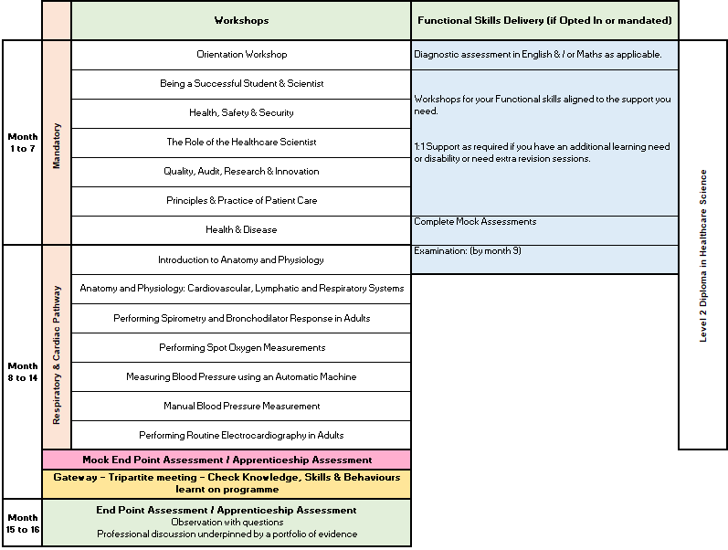
Healthcare Science Assistant Level 2: Respiratory Cardiac
Notes:
Orientation Workshop
Introduction to programme structure, expectations and support.
Using online platforms and digital systems effectively.
Developing good study habits, time management and independent learning skills.
Core Session 2 – Being a Successful Student and Scientist
This session focuses on professional development as a healthcare scientist. It covers the importance of appraisals, how to prepare for them, and understanding the NHS Leadership Model. Participants will also explore their roles within healthcare, potential career paths, and the significance of reflective practice for continuous learning.
Core Session 3 – Health, Safety and Security
Participants will learn about health and safety responsibilities in the workplace, including their own duties and those of others. The session also covers responding to accidents, safe handling of equipment and hazardous materials, promoting fire safety, and understanding risk assessment principles.
Core Session 4 – The Role of the Healthcare Scientist
This session delves into the diverse roles within healthcare science, emphasizing the importance of technical documentation and patient confidentiality. Attendees will also learn strategies for effective communication and collaboration within healthcare teams.
Core Session 5 – Quality, Audit, Research and Innovation
This session introduces key legislation, policies, and procedures related to workplace quality standards. It explains audit principles, the concept of competence, and the use of quality resources. Participants will also explore how research and innovation drive advancements in healthcare.
Core Session 6 – Principles and Practice of Patient Care
Participants will gain an understanding of the NHS Core Values and key patient care concepts. The session emphasizes adherence to relevant codes of conduct, the rights of both patients and healthcare professionals, and strategies for promoting mental health and well-being.
Core Session 7 – Health and Disease
This session examines the definitions of health and disease, the causes and transmission of infections, and factors that influence health. Participants will explore common causes of disease, methods for prevention, and ways to support patients in managing their health. The role of national public health bodies is also discussed.
Unit 21: Introduction to Anatomy and Physiology
Introduces the terms anatomy and physiology
Explains how body structure links to body function
Covers body organisation from cells to full body systems
Identifies the major body systems
Explores common diseases linked to each system
Considers the impact of disease on patients and families
Introduces diagnostic tests across life sciences, physiological sciences and physical sciences
Unit 24: Cardiovascular, Lymphatic and Respiratory Systems
Covers the anatomy and physiology of blood, blood vessels and the heart
Explores the lymphatic and immune systems
Explains respiratory system structure and function
Links body systems to related disorders
Introduces tests used to diagnose, treat and manage cardiovascular, respiratory, lymphatic, immune and sleep disorders
Unit 79: Performing Spirometry and Bronchodilator Response in Adults
Duration: 1 month
Covers respiratory anatomy and physiology
Explains the mechanics of breathing
Introduces spirometry, spirometers and respiratory diseases
Covers clinical indications and key definitions
Explains the SOP for spirometry and reversibility testing
Develops skills in preparing and performing spirometry
Focuses on obtaining reliable baseline measurements
Unit 80: Performing Spot Oxygen Measurements
Explains the meaning and clinical use of SpO₂
Covers conditions that may affect SpO₂ measurements
Introduces the principles of pulse oximetry
Explains the SOP for spot oxygen measurement
Develops skills in preparing and performing SpO₂ readings
Focuses on obtaining reliable baseline measurements
Includes maintaining oximeters
Unit 72: Measuring Blood Pressure Using an Automatic Machine
Explains the purpose of blood pressure measurement
Introduces automatic BP equipment used in practice
Covers preparation of the setting and patient
Develops skills in measuring resting BP in adults
Includes accurate recording and documentation of results
Unit 78: Manual Blood Pressure Measurement
Explains the purpose and principles of manual BP measurement
Covers physiological changes and natural variability in blood pressure
Develops skills in preparing adults for BP measurement
Includes conducting and documenting the procedure
Introduces quality assurance processes for manual BP measurement
Unit 73: Performing Routine Electrocardiography in Adults
Covers normal heart structure, function and electrical activity
Explains how heart function relates to a normal ECG
Covers safe recording of a 12-lead ECG
Focuses on effective patient communication
Develops skills in performing ECGs for routine adult patients
Includes checking ECG technical quality
Introduces recognition and appropriate response to life-threatening arrhythmias

Slide 15
Respiratory & Cardiac: Off-the-Job learning activities include:
Completion of assessments is counted towards off-the-job hours.
Practice reflections through the reflective diary task and find reflective models that feel natural to write with.
Speak with the local health and safety officer for information on relevant policies and guidelines.
Complete extracurricular reading on subjects such as hazardous material handling and management.
Research the healthcare science divisions and reflect on the roles and responsibilities of science in patient care.
Study local document control procedures and discuss with senior staff how policies are developed and published.
Participate in the audit procedure with guidance from trained staff to develop an understanding of audits.
Shadow a staff member performing quality procedures / Sit in on a quality-based meeting.
Research various diseases and infection routes.
Shadow the infection control team for half a day.
Research local hospital policies and procedures for high-risk and infectious diseases from patient admission to ward decontamination after discharge.
Shadowing in pathology, respiratory, or cardiac departments.
Observing non-patient-contact diagnostic procedures (e.g., haematology analyser) and assisting with ECG recording
Viewing or performing spirometry or pulse oximetry measurements.
Spirometry simulation practice/ Observation of spirometry and reversibility clinics.
Shadowing respiratory physiologists.
Demonstration sessions on pulse oximeters.
Shadowing hypertension clinics.
Practice on peers using different devices.
Compare normal ECGs with mild and severe artefacts; learners diagnose the problem.
Identify arrhythmias beyond the required level (e.g., atrial flutter vs fibrillation).
Practice troubleshooting poor-quality traces using SCST guidance.
Simulated ECG recordings and peer assessments.

Slide 16
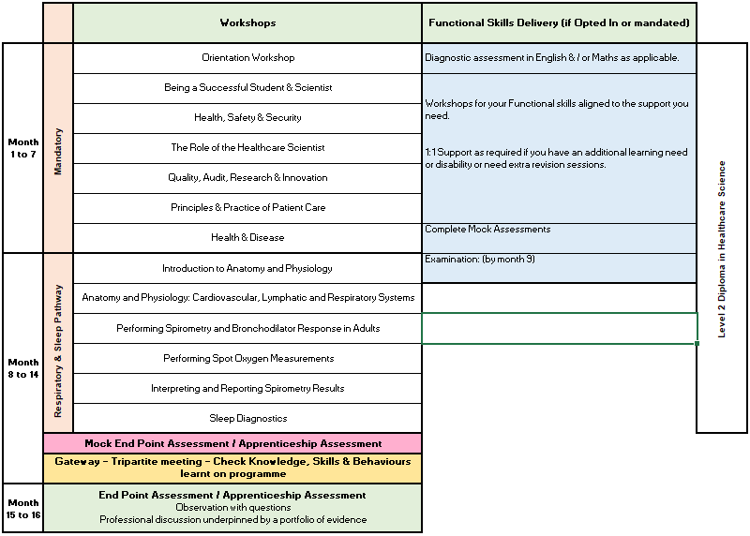
Healthcare Science Assistant Level 2: Respiratory Sleep
Notes:
Orientation Workshop
Introduction to programme structure, expectations and support.
Using online platforms and digital systems effectively.
Developing good study habits, time management and independent learning skills.
Core Session 2 – Being a Successful Student and Scientist
This session focuses on professional development as a healthcare scientist. It covers the importance of appraisals, how to prepare for them, and understanding the NHS Leadership Model. Participants will also explore their roles within healthcare, potential career paths, and the significance of reflective practice for continuous learning.
Core Session 3 – Health, Safety and Security
Participants will learn about health and safety responsibilities in the workplace, including their own duties and those of others. The session also covers responding to accidents, safe handling of equipment and hazardous materials, promoting fire safety, and understanding risk assessment principles.
Core Session 4 – The Role of the Healthcare Scientist
This session delves into the diverse roles within healthcare science, emphasizing the importance of technical documentation and patient confidentiality. Attendees will also learn strategies for effective communication and collaboration within healthcare teams.
Core Session 5 – Quality, Audit, Research and Innovation
This session introduces key legislation, policies, and procedures related to workplace quality standards. It explains audit principles, the concept of competence, and the use of quality resources. Participants will also explore how research and innovation drive advancements in healthcare.
Core Session 6 – Principles and Practice of Patient Care
Participants will gain an understanding of the NHS Core Values and key patient care concepts. The session emphasizes adherence to relevant codes of conduct, the rights of both patients and healthcare professionals, and strategies for promoting mental health and well-being.
Core Session 7 – Health and Disease
This session examines the definitions of health and disease, the causes and transmission of infections, and factors that influence health. Participants will explore common causes of disease, methods for prevention, and ways to support patients in managing their health. The role of national public health bodies is also discussed.
Unit 21: Introduction to Anatomy and Physiology
Introduces the terms anatomy and physiology
Explains how body structure links to body function
Covers body organisation from cells to full body systems
Identifies the major body systems
Explores common diseases linked to each system
Considers the impact of disease on patients and families
Introduces diagnostic tests across life sciences, physiological sciences and physical sciences
Unit 24: Cardiovascular, Lymphatic and Respiratory Systems
Covers the anatomy and physiology of blood, blood vessels and the heart
Explores the lymphatic and immune systems
Explains respiratory system structure and function
Links body systems to related disorders
Introduces tests used to diagnose, treat and manage cardiovascular, respiratory, lymphatic, immune and sleep disorders
Unit 79: Performing Spirometry and Bronchodilator Response in Adults
Duration: 1 month
Covers respiratory anatomy and physiology
Explains the mechanics of breathing
Introduces spirometry, spirometers and respiratory diseases
Covers clinical indications and key definitions
Explains the SOP for spirometry and reversibility testing
Develops skills in preparing and performing spirometry
Focuses on obtaining reliable baseline measurements
Unit 80: Performing Spot Oxygen Measurements
Explains the meaning and clinical use of SpO₂
Covers conditions that may affect SpO₂ measurements
Introduces the principles of pulse oximetry
Explains the SOP for spot oxygen measurement
Develops skills in preparing and performing SpO₂ readings
Focuses on obtaining reliable baseline measurements
Includes maintaining oximeters
Unit 82: Interpreting and Reporting Spirometry Results
Covers obstructive, restrictive and mixed spirometry patterns
Explains reversibility testing and result interpretation
Introduces reference values and how to use them
Develops skills in producing technical spirometry reports
Includes interpretive reporting of spirometry results
Supports accurate communication of respiratory test findings
Unit 116: Sleep Diagnostics
Introduces breathing-related sleep disorders
Explains how sleep and sleep disorders are investigated
Covers diagnostic testing in adults and/or children
Develops skills in performing standard sleep diagnostic tests
Includes cleaning and decontamination of equipment
Covers routine equipment maintenance
Includes quality assurance procedures for sleep diagnostic equipment

Slide 17
Respiratory & Sleep: Off-the-Job learning activities include:
Completion of assessments is counted towards off-the-job hours.
Practice reflections through the reflective diary task and find reflective models that feel natural to write with.
Speak with the local health and safety officer for information on relevant policies and guidelines.
Complete extracurricular reading on subjects such as hazardous material handling and management.
Research the healthcare science divisions and reflect on the roles and responsibilities of science in patient care.
Study local document control procedures and discuss with senior staff how policies are developed and published.
Participate in the audit procedure with guidance from trained staff to develop an understanding of audits.
Shadow a staff member performing quality procedures / Sit in on a quality-based meeting.
Research various diseases and infection routes.
Shadow the infection control team for half a day.
Research local hospital policies and procedures for high-risk and infectious diseases from patient admission to ward decontamination after discharge.
Shadowing in pathology, respiratory, or cardiac departments.
Observing non-patient-contact diagnostic procedures (e.g., haematology analyser).
Observing or assisting with ECG recording (under supervision).
Viewing or performing spirometry or pulse oximetry measurements.
Review anonymised case studies as part of MDT discussions.
Spirometry simulation practice.
Shadowing respiratory physiologists.
Observation of spirometry and reversibility clinics.
Demonstration sessions on pulse oximeters.
Shadowing clinical staff in outpatient clinics.
Interpret anonymised spirometry datasets.
Attend MDT respiratory clinics and sleep clinics.
Online spirometry interpretation modules.
Interpret anonymised sleep study results.

Slide 18
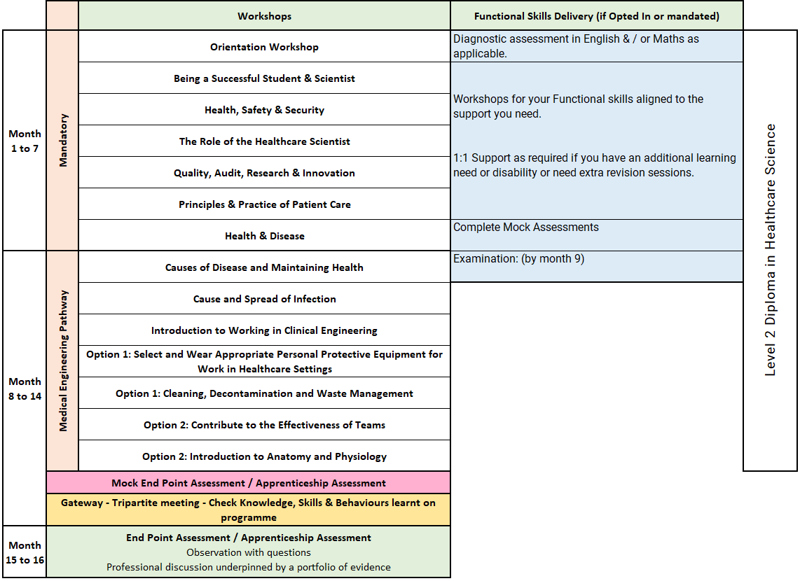
Healthcare Science Assistant Level 2: Medical Engineering
Notes:
Orientation Workshop
Introduction to programme structure, expectations and support.
Using online platforms and digital systems effectively.
Developing good study habits, time management and independent learning skills.
Core Session 2 – Being a Successful Student and Scientist
This session focuses on professional development as a healthcare scientist. It covers the importance of appraisals, how to prepare for them, and understanding the NHS Leadership Model. Participants will also explore their roles within healthcare, potential career paths, and the significance of reflective practice for continuous learning.
Core Session 3 – Health, Safety and Security
Participants will learn about health and safety responsibilities in the workplace, including their own duties and those of others. The session also covers responding to accidents, safe handling of equipment and hazardous materials, promoting fire safety, and understanding risk assessment principles.
Core Session 4 – The Role of the Healthcare Scientist
This session delves into the diverse roles within healthcare science, emphasizing the importance of technical documentation and patient confidentiality. Attendees will also learn strategies for effective communication and collaboration within healthcare teams.
Core Session 5 – Quality, Audit, Research and Innovation
This session introduces key legislation, policies, and procedures related to workplace quality standards. It explains audit principles, the concept of competence, and the use of quality resources. Participants will also explore how research and innovation drive advancements in healthcare.
Core Session 6 – Principles and Practice of Patient Care
Participants will gain an understanding of the NHS Core Values and key patient care concepts. The session emphasizes adherence to relevant codes of conduct, the rights of both patients and healthcare professionals, and strategies for promoting mental health and well-being.
Core Session 7 – Health and Disease
This session examines the definitions of health and disease, the causes and transmission of infections, and factors that influence health. Participants will explore common causes of disease, methods for prevention, and ways to support patients in managing their health. The role of national public health bodies is also discussed.
nits 11 & 12: Causes of Disease, Maintaining Health, and Cause and Spread of Infection
Delivered as a combined online unit
Duration: 1 month
Explores definitions of health and disease
Covers causes of disease and ways to maintain health and wellbeing
Introduces key micro-organisms, including:
bacteria
viruses
fungi
parasites
Explains routes of infection and transmission
Covers conditions needed for micro-organisms to grow
Discusses departmental infection control procedures
Explores how to reduce the risk of infection outbreaks
Introduces the role of Public Health agencies
Includes group activities, self-study and workbook completion
Unit 103: Introduction to Working in Clinical Engineering
Duration: 2 months
Develops knowledge, skills and professional attitudes for working in a medical engineering workshop
Focuses on safe and effective practice within a clinical engineering environment
Primarily delivered through work-based activities
Learners gather evidence of competence, such as:
competency records
maintenance logs
daily checklists
witness testimonies
further departmental training records
Supports development of workplace confidence and technical competence in clinical engineering

Slide 19
Medical Engineering: Off-the-Job learning activities include:
Completion of assessments is counted towards off-the-job hours.
Practice reflections through the reflective diary task and find reflective models that feel natural to write with.
Speak with the local health and safety officer for information on relevant policies and guidelines.
Complete extracurricular reading on subjects such as hazardous material handling and management.
Research the healthcare science divisions and reflect on the roles and responsibilities of science in patient care.
Study local document control procedures and discuss with senior staff how policies are developed and published.
Participate in the audit procedure with guidance from trained staff to develop an understanding of audits.
Shadow a staff member performing quality procedures / Sit in on a quality-based meeting.
Research various diseases and infection routes.
Shadow the infection control team for half a day.
Research local hospital policies and procedures for high-risk and infectious diseases from patient admission to ward decontamination after discharge.
Pathway Specific
Undertake independent research related to the subject matter, particularly to support the presentation.
Attend a Multi-Disciplinary Team (MDT/MDM) meeting where patient pathways and diagnostic tests are discussed.
Observe clinical equipment in use to understand its role in patient care and the overall patient journey.
Attend Trust/organisational quality meetings where audit and data are reviewed, including topics such as infection control and hospital-acquired infections (HAIs).
Participate in a comorbidity meeting where unexpected or unexplained patient deaths are reviewed, including root cause analysis.

Slide 20
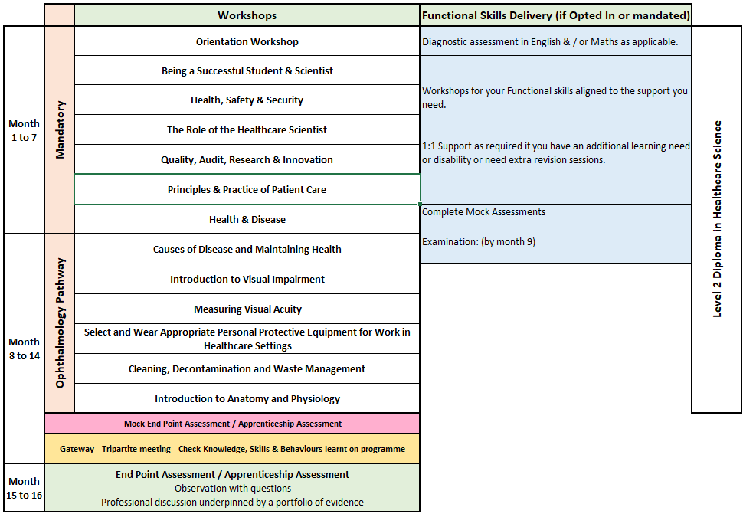
Healthcare Science Assistant Level 2: Ophthalmology
Notes:
Orientation Workshop
Introduction to programme structure, expectations and support.
Using online platforms and digital systems effectively.
Developing good study habits, time management and independent learning skills.
Core Session 2 – Being a Successful Student and Scientist
This session focuses on professional development as a healthcare scientist. It covers the importance of appraisals, how to prepare for them, and understanding the NHS Leadership Model. Participants will also explore their roles within healthcare, potential career paths, and the significance of reflective practice for continuous learning.
Core Session 3 – Health, Safety and Security
Participants will learn about health and safety responsibilities in the workplace, including their own duties and those of others. The session also covers responding to accidents, safe handling of equipment and hazardous materials, promoting fire safety, and understanding risk assessment principles.
Core Session 4 – The Role of the Healthcare Scientist
This session delves into the diverse roles within healthcare science, emphasizing the importance of technical documentation and patient confidentiality. Attendees will also learn strategies for effective communication and collaboration within healthcare teams.
Core Session 5 – Quality, Audit, Research and Innovation
This session introduces key legislation, policies, and procedures related to workplace quality standards. It explains audit principles, the concept of competence, and the use of quality resources. Participants will also explore how research and innovation drive advancements in healthcare.
Core Session 6 – Principles and Practice of Patient Care
Participants will gain an understanding of the NHS Core Values and key patient care concepts. The session emphasizes adherence to relevant codes of conduct, the rights of both patients and healthcare professionals, and strategies for promoting mental health and well-being.
Core Session 7 – Health and Disease
This session examines the definitions of health and disease, the causes and transmission of infections, and factors that influence health. Participants will explore common causes of disease, methods for prevention, and ways to support patients in managing their health. The role of national public health bodies is also discussed.
Month 8–9: Units 11 & 12
Causes of Disease, Maintaining Health, and Cause and Spread of Infection
Delivered as a combined online unit
Duration: 1 month
Explores definitions of health and disease
Covers different causes of disease
Explains how to maintain health and wellbeing
Introduces key micro-organisms, including:
bacteria
viruses
fungi
parasites
Explains routes of infection and transmission
Covers conditions needed for micro-organisms to grow
Discusses departmental infection control procedures
Explores how to reduce the risk of infection outbreaks
Introduces the role of Public Health agencies
Includes group activities, self-study and workbook completion

Slide 21
Ophthalmology: Off-the-Job learning activities include:
Completion of assessments is counted towards off-the-job hours.
Practice reflections through the reflective diary task and find reflective models that feel natural to write with.
Speak with the local health and safety officer for information on relevant policies and guidelines.
Complete extracurricular reading on subjects such as hazardous material handling and management.
Research the healthcare science divisions and reflect on the roles and responsibilities of science in patient care.
Study local document control procedures and discuss with senior staff how policies are developed and published.
Participate in the audit procedure with guidance from trained staff to develop an understanding of audits.
Shadow a staff member performing quality procedures / Sit in on a quality-based meeting.
Research various diseases and infection routes.
Shadow the infection control team for half a day.
Research local hospital policies and procedures for high-risk and infectious diseases from patient admission to ward decontamination after discharge.
Pathway Specific
Undertake independent research related to the subject matter, particularly to support the presentation.
Trust/Organisational Quality Meetings where audit and data are discussed, particularly relating to Infection Control and Hospital Acquired Infections (HAIs)Trust/Organisational Quality Meetings covering patient feedback or waiting time data.
Attend a Comorbidity Meeting where unexpected or unexplained patient deaths are reviewed, including root cause analysis.
Attend a Multi-Disciplinary Team (MDT/MDM) meeting to understand the patient pathway using diagnostic tests.
Observe clinic sessions with a clinician to discuss diagnosis and treatment planning.
Opportunities to observe corrective procedures (e.g. small surgeries, cataract operations, lens replacement)

Slide 22
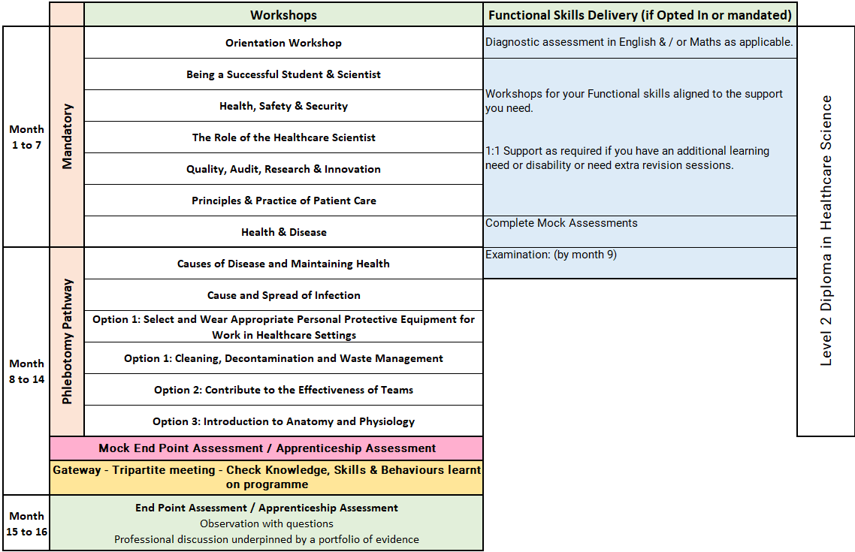
Healthcare Science Assistant Level 2: Phlebotomy
Notes:
Orientation Workshop
Introduction to programme structure, expectations and support.
Using online platforms and digital systems effectively.
Developing good study habits, time management and independent learning skills.
Core Session 2 – Being a Successful Student and Scientist
This session focuses on professional development as a healthcare scientist. It covers the importance of appraisals, how to prepare for them, and understanding the NHS Leadership Model. Participants will also explore their roles within healthcare, potential career paths, and the significance of reflective practice for continuous learning.
Core Session 3 – Health, Safety and Security
Participants will learn about health and safety responsibilities in the workplace, including their own duties and those of others. The session also covers responding to accidents, safe handling of equipment and hazardous materials, promoting fire safety, and understanding risk assessment principles.
Core Session 4 – The Role of the Healthcare Scientist
This session delves into the diverse roles within healthcare science, emphasizing the importance of technical documentation and patient confidentiality. Attendees will also learn strategies for effective communication and collaboration within healthcare teams.
Core Session 5 – Quality, Audit, Research and Innovation
This session introduces key legislation, policies, and procedures related to workplace quality standards. It explains audit principles, the concept of competence, and the use of quality resources. Participants will also explore how research and innovation drive advancements in healthcare.
Core Session 6 – Principles and Practice of Patient Care
Participants will gain an understanding of the NHS Core Values and key patient care concepts. The session emphasizes adherence to relevant codes of conduct, the rights of both patients and healthcare professionals, and strategies for promoting mental health and well-being.
Core Session 7 – Health and Disease
This session examines the definitions of health and disease, the causes and transmission of infections, and factors that influence health. Participants will explore common causes of disease, methods for prevention, and ways to support patients in managing their health. The role of national public health bodies is also discussed.
Units 11 & 12: Causes of Disease, Maintaining Health, and Cause and Spread of Infection
Delivered as a combined online unit
Duration: 1 month
Explores definitions of health and disease
Covers different causes of disease
Explains how to maintain health and wellbeing
Introduces key micro-organisms, including:
bacteria
viruses
fungi
parasites
Explains routes of infection and transmission
Covers conditions needed for micro-organisms to grow
Discusses departmental infection control procedures
Explores how to reduce the risk of infection outbreaks
Introduces the role of Public Health agencies
Includes group activities, self-study and workbook completion

Slide 23
Phlebotomy: Off-the-Job learning activities include:
Practice reflections through the reflective diary task and find reflective models that feel natural to write with.
Speak with the local health and safety officer for information on relevant policies and guidelines.
Complete extracurricular reading on subjects such as hazardous material handling and management.
Research the healthcare science divisions and reflect on the roles and responsibilities of science in patient care.
Study local document control procedures and discuss with senior staff how policies are developed and published.
Participate in the audit procedure with guidance from trained staff to develop an understanding of audits.
Shadow a staff member performing quality procedures / Sit in on a quality-based meeting.
Research various diseases and infection routes.
Shadow the infection control team for half a day.
Research local hospital policies and procedures for high-risk and infectious diseases from patient admission to ward decontamination after discharge.
Pathway Specific
Undertake independent research related to the subject matter, particularly to support the presentation.
Trust/Organisational Quality Meetings where audit and data are discussed, including Infection Control, Hospital
Acquired Infections (HAIs), patient feedback, and waiting times
Attend a Comorbidity Meeting where unexpected or unexplained patient deaths are reviewed, including root cause analysis
Attend a Multi-Disciplinary Team (MDT/MDM) meeting to understand the wider patient journey and how diagnostic tests inform patient pathways
Follow a patient, client, or service user’s sample from Point of Care Testing (POCT) through to the laboratory to observe the full healthcare science process, including the generation of results

Slide 24
Progression Opportunities
On successful completion of the programme, participants may:
Apply for Professional Registration: Healthcare science assistants are eligible to apply to join the Academy for Healthcare Science (AHCS) accredited register.
Move Into specialists roles relevant to their future role pathways with their employer.
Participants may also progress to:
Level 4 Healthcare Science Associate Programmes and their chosen pathways.
Other internal CPD opportunities.

Slide 25
Apprenticeships: What You Need to Know
An apprenticeship is a work-based learning programme
Developed by employers from the sector.
Funded through the apprenticeship Levy.
Suitable for new entrants and existing staff developing their careers.
An apprenticeship consists of:
An apprenticeship is a work-based learning programme.
Knowledge of the areas involved in the staff's role at the appropriate level.
Skills the learner is expected to demonstrate competently.
An option to upskilling in maths and English and achievement of functional skills (if not mandated).
Achievement of Diploma or other requirement subject to the needs of the apprenticeship standard.

Slide 26
The Apprenticeship Journey
Application
On
Programme
Assessment
Gateway
EPA / Apprenticeship Assessment
(example)
Completion
Observation in practice
Information
Off the job training
Preparation for assessment
Achievement
Application & eligibility check
Multiple choice exam
Standard/Diploma
/Other
Evidence of programme achievement 100%
Certification
Assessments & induction
Reflective journal and interview
English & maths opt in
Ready for EPA/ Apprenticeship Assessment
Progression

Slide 27







Apprenticeship Support
Learning Support Assistant
Skills & Development Coach
Employer including: Line Manager /Mentor
Functional Skills Tutor
Supported employment service Job Coach
Apprentice / Learner
Apprenticeship Assessment Organisation

Slide 28
Reasonable adjustments to learning and assessment
Reasonable adjustments can be made for example:
Extra time allowance.
Assistive technology.
Alternative assessment methods.
British sign language interpreter.
Timed rest breaks.
One to one support.
Increased support.

Slide 29
Understanding Functional Skills
Notes:
Apprentices with an undiagnosed learning difficulty or disability may be able to access this flexibility by completing a detailed assessment with our specialist coach.

Slide 30
Dedicated Learning Time
Teaching & Learning Reviews
⏱ 2 hours (every 4–6 weeks)
• In person or online
• Learner meets with Coach
• Feedback shared with Line Manager / Workplace Mentor
Online Workshops (MS Teams)
📅 Approx. monthly
• Full‑day workshops
• Aligned to the apprenticeship standard
• Dates confirmed at programme start
10 –12 Week Progress Reviews
⏱ 90 minutes
• Three‑way review: Coach, Learner, Line Manager / Mentor
• Review progress, impact of learning and next steps
Independent Learning /
Study Time
⏱ Weekly commitment
• Minimum half a day per week
• 1–2 hours focused work‑based learning
Notes:
Responsibilities
The Apprentice
Complete work meeting targets set
Attend any training sessions made available
Communicate clearly and regularly with Tutor
Commence Functional Skills from the beginning of their programme if required to complete
Complete and record off-the-Job activity every month
Independent learning / time for study – reading, watching developmental videos, research tasks and projects
Line Manager/Mentor
Support development of the learner, giving opportunity to practice new skills attained in the workplace
Allow the learner to attend all agreed Tutor sessions and allow protected time for reflection and written work
Support with off-the-job learning identification and recording
Attend progress reviews
In work learning opportunities – Shadowing, stepping up, coaching, mentoring
Dynamic Training
Create an individual learning plan
Identify any recognition of prior learning
Provide quality training, support and assessment
Provide regular feedback and development opportunities
Adapt delivery and assessment to meet individual needs where applicable

Slide 31






E-learning Tools
The tools learners use to support achievement of their apprenticeship programme

Slide 32

UCAS Points
Individuals completing apprenticeships may be awarded up to 112 UCAS points, depending on the length of their apprenticeship.
Apprentices must pass their end-point assessment / Apprenticeship Assessment to utilise these points for university applications (including higher, degree level apprenticeship programmes)
Notes:
Length is duration planned not how long the programme takes to achieve. i.e. if a learner achieves earlier they get the planned duration UCAs tariff points.

Slide 33
Employer Grants & Incentives
£1,000 — Young Apprentice Incentive
Employers can receive £1,000 for taking on an apprentice aged 16 to 18 years old, or aged 19 to 24 years old with an Education, Health and Care Plan, or who is a care leaver.
Employer eligibility: All sizes of employer
Availability: Available now
£2,000 — Non-Levy Jobs Grant
From October 2026, employers that do not pay the apprenticeship levy could receive up to £2,000 for hiring an apprentice aged 16 to 24, and new employees within the previous 3 months.
Employer eligibility: Only for non-levy employers
Availability: Available from October 2026
£3,000 — Youth Jobs Grant
Businesses can receive £3,000 for hiring an individual aged 18 to 24 who has been receiving Universal Credit and looking for work for six months or more.
Employer eligibility: All sizes of employer
Availability: Available now
£2,000 — Foundation Apprenticeship Incentive
Employers offering Foundation Apprenticeships to young people aged 16 to 21, or eligible 22 to 24 year olds, can receive up to £2,000.
Payments support progression to a further apprenticeship.
Employer eligibility: All sizes of employer
Availability: Available now

Slide 34
Additional Incentives
National Insurance Contributions
Employers do not pay National Insurance Contributions for apprentices aged under 25 years, or for any employee aged 21 or below, if salary is below £50,270.
Rate referenced: 2025/26 rate
Funding for Under 25s
Non-levy employers do not pay training costs for apprentices aged under 25.
For those aged 25+, the cost is 5%, or zero if using a levy transfer.
Care Leavers’ Bursary
Eligible apprentices aged 18 to 24 can receive an additional £3,000 from government, in addition to their salary.
This payment is tax free.
Employers may be able to access multiple incentives for the same young person where eligibility criteria are met.

Slide 35
Questions for Reflection
How would this benefit me?
Would I be able to commit?
What other commitments do I currently have?
Would my department support this?
What would I need from my employer to support me?

Slide 36
Next Steps
Make an informed decision if the apprenticeship programme is right for you?
If yes!
Follow your companies expression of Interest process to start the enrolment process or
Email us and we will contact your employer direct – ask.dynamic@dynamictraining.org.uk
Find out more about the programmes via our website www.dynamictraining.org.uk
Speak to one our team to answer your questions via email ask.dynamic@dynamictraining.org.uk or call 0208 607 7850

