Slide 1

Healthcare Science Associate Level 4 Apprenticeships.

Slide 2
Who are Dynamic Training
Established in 2007
Centres in Uxbridge and Hartlepool
Delivering
Apprenticeships
&
Bespoke Training Solutions
Supporting circa 500 learners on a variety of programmes at any one time
Over 80 NHS Trusts choose Dynamic Training with their ongoing Learning & Development Needs
Matrix Accredited.
A Skills for Care Endorsed provider.
A disability confident employer
Part of Calder Holding BV
13 companies with 1000+ employees in the UK and the Netherlands.
Retained our Ofsted “good” inspection grade in June 2025

Slide 3
Off the Job Learning
As part of this apprenticeship, participants complete a minimum of 578 hours of Off-the-Job learning over the duration of the programme.
Off-the-Job learning takes place during paid working hours and supports the development of the knowledge, skills and behaviours required within the Healthcare Science Associate apprenticeship.
Of the Job learning is essential, mandatory requirement of an apprenticeship to enable the learner and employer to see impactful learning that takes place.
Notes:
Explain there are multiple pathways associated to the healthcare science associate apprenticeship programme ask to add interest in comments so as to then focus on interest based on audience

Slide 4
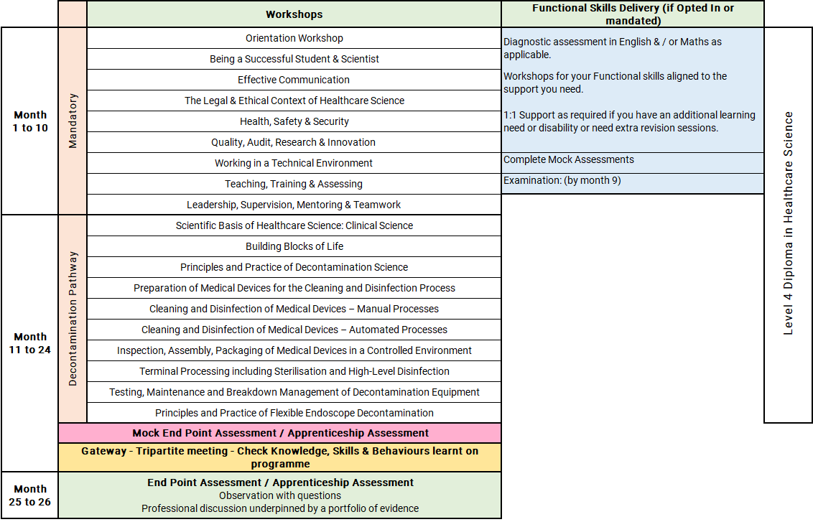
Healthcare Science Associate Level 4: Decontamination
Notes:
Orientation Workshop
Introduction to programme structure, expectations and support.
Using online platforms and digital systems effectively.
Developing good study habits, time management and independent learning skills.
Workshop 2: Being a Successful Student & Scientist (Part 1)
Synopsis:
This session builds on the initial OneFile induction, providing learners with the skills to effectively manage their learning journey. It covers logging journal entries, recording off-the-job training, using the Skills Builder, and navigating Microsoft Teams to support communication and collaboration.
Workshop 3: Effective Communication (Part 2)
Synopsis:
This workshop develops core communication skills, including verbal, non-verbal, and written methods, alongside active listening and feedback. Learners will explore how to overcome communication barriers, deliver effective presentations, and manage challenging situations such as conflict, applying these skills in practical scenarios.
Workshop 4: The Legal & Ethical Context of Healthcare Science (Part 3)
Synopsis:
Learners gain an understanding of the legal, ethical, and professional frameworks underpinning healthcare science. Topics include NHS values, organisational structure, informed consent, professional standards, and the impact of mental health, helping learners apply ethical decision-making in practice.
Workshop 5: Health, Safety & Security (Part 4)
Synopsis:
This session introduces key health and safety principles within the NHS, including legislation, duty of care, safeguarding, and risk management. Learners will explore incident reporting, promoting a no-blame culture, and their role in maintaining a safe working environment.
Workshop 6: Quality, Audit, Research & Innovation (Part 5)
Synopsis:
Learners explore the importance of quality standards, audit processes, research principles, and innovation in healthcare science. The session supports understanding how these elements improve practice and encourages learners to engage with quality improvement and innovation in their workplace.
Workshop 7: Working in a Technical Environment (Part 6)
Synopsis:
This workshop focuses on the role of technical scientific services in patient care. Learners will develop problem-solving skills, understand equipment lifecycle management, and demonstrate safe and effective practice while maintaining professional standards.
Workshop 8: Teaching, Training & Assessing (Part 7)
Synopsis:
Learners are introduced to key teaching and learning theories and how they apply in the workplace. The session covers assessment methods, feedback models, and practical teaching frameworks, enabling learners to support others’ development effectively.
Workshop 9: Leadership, Supervision, Mentoring & Teamwork (Part 8)
Synopsis:
This session develops understanding of leadership and teamwork within healthcare settings. Learners explore leadership models, effective teamworking, mentoring, and supervision, alongside promoting a supportive, no-blame culture in multidisciplinary environments.
Units 11 & 17: Scientific Basis of Healthcare Science and Building Blocks of Life
Delivered as a combined unit
Duration: 4 months
Introduces the scientific basis of healthcare science
Covers key clinical science principles
Explores the building blocks of life
Supports understanding of biological structures and processes
Provides foundation knowledge for decontamination science and clinical practice
Decontamination Science Units Covered
Units 39–46
Covers the principles and practice of decontamination science
Introduces preparation of medical devices for cleaning and disinfection
Explains manual cleaning and disinfection processes
Covers automated cleaning and disinfection processes
Develops understanding of inspection, assembly and packaging of medical devices
Explains working in a controlled environment
Covers terminal processing, including:
sterilisation
high-level disinfection
Introduces testing, maintenance and breakdown management of decontamination equipment
Covers flexible endoscope decontamination
Supports safe, effective and compliant reprocessing of medical devices

Slide 5
Decontamination: Off-the-Job learning activities include:
Appraisal to be completed and annotated with career plan discussed and developed.
Develop and review different types of communication methods to communicate within your role.
Complete a risk assessment relevant to your area of practice using local procedures.
Produce guidance for a new starter detailing hazardous materials and substances in your workplace and how to manage them safely.
Undertake an innovation or improvement within your workplace.
Participate in drafting at least 2 standard operating procedures within your area of work.
Produce reports demonstrating your understanding and ability to perform Quality Control and Quality Assurance.
Lead a quality management technical audit process, demonstrating your participation in service improvements within your department.
Deliver training and competency assessment to a junior staff member
Pathways specific
Attending a Multi-Disciplinary Team Meeting (MDM/MDT) where a patient’s pathway is being discussed using diagnostic tests.
Spending time with the Patient Liaison Service to see how they manage queries/complaints
Attend a Comorbidity Meeting where any unexpected or unexplained patient deaths are discussed. Root cause analysis would be included in these sessions.
Understanding the wider patient journey by attending a Multi-Disciplinary Team Meeting (MDM/MDT) where a patient’s pathway is being discussed using diagnostic tests.
Any opportunities to see any procedures either in Theatres or Endoscopy where scopes have been used.
Any Trust/Organisational Quality Meetings where audit and data is being discussed, particularly anything in relation to Infection Control and Hospital Acquired Infections (HAI’s).

Slide 6
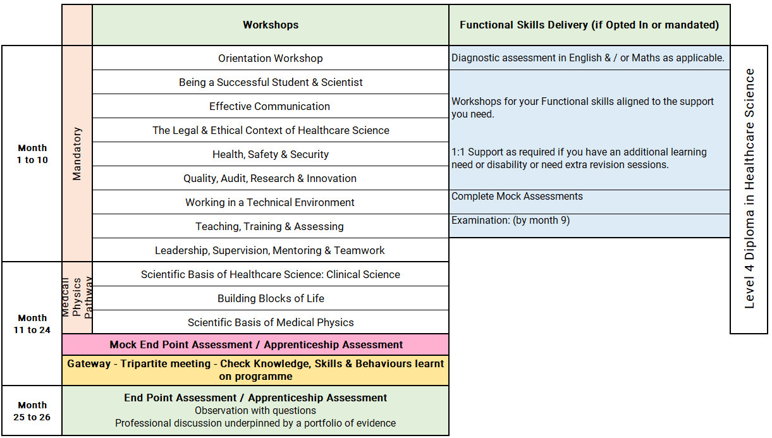
Healthcare Science Associate Level 4: Medical Physics
Notes:
Orientation Workshop
Introduction to programme structure, expectations and support.
Using online platforms and digital systems effectively.
Developing good study habits, time management and independent learning skills.
Workshop 2: Being a Successful Student & Scientist (Part 1)
Synopsis:
This session builds on the initial OneFile induction, providing learners with the skills to effectively manage their learning journey. It covers logging journal entries, recording off-the-job training, using the Skills Builder, and navigating Microsoft Teams to support communication and collaboration.
Workshop 3: Effective Communication (Part 2)
Synopsis:
This workshop develops core communication skills, including verbal, non-verbal, and written methods, alongside active listening and feedback. Learners will explore how to overcome communication barriers, deliver effective presentations, and manage challenging situations such as conflict, applying these skills in practical scenarios.
Workshop 4: The Legal & Ethical Context of Healthcare Science (Part 3)
Synopsis:
Learners gain an understanding of the legal, ethical, and professional frameworks underpinning healthcare science. Topics include NHS values, organisational structure, informed consent, professional standards, and the impact of mental health, helping learners apply ethical decision-making in practice.
Workshop 5: Health, Safety & Security (Part 4)
Synopsis:
This session introduces key health and safety principles within the NHS, including legislation, duty of care, safeguarding, and risk management. Learners will explore incident reporting, promoting a no-blame culture, and their role in maintaining a safe working environment.
Workshop 6: Quality, Audit, Research & Innovation (Part 5)
Synopsis:
Learners explore the importance of quality standards, audit processes, research principles, and innovation in healthcare science. The session supports understanding how these elements improve practice and encourages learners to engage with quality improvement and innovation in their workplace.
Workshop 7: Working in a Technical Environment (Part 6)
Synopsis:
This workshop focuses on the role of technical scientific services in patient care. Learners will develop problem-solving skills, understand equipment lifecycle management, and demonstrate safe and effective practice while maintaining professional standards.
Workshop 8: Teaching, Training & Assessing (Part 7)
Synopsis:
Learners are introduced to key teaching and learning theories and how they apply in the workplace. The session covers assessment methods, feedback models, and practical teaching frameworks, enabling learners to support others’ development effectively.
Workshop 9: Leadership, Supervision, Mentoring & Teamwork (Part 8)
Synopsis:
This session develops understanding of leadership and teamwork within healthcare settings. Learners explore leadership models, effective teamworking, mentoring, and supervision, alongside promoting a supportive, no-blame culture in multidisciplinary environments.
Units 11 & 17: Scientific Basis of Healthcare Science and Building Blocks of Life
Delivered as a combined unit
Duration: 4 months
Uses online classroom activities, self-study and the ATOM virtual learning platform
Explores anatomy, physiology and pathology of the major body systems
Covers the classification, structure and function of cells and tissues
Introduces genetics, including genes, chromosomes, DNA and the human genome
Covers carbohydrates, lipids and amino acids
Explains the role of proteins in biological systems
Explores chemical, cellular and tissue organisation of the body
Links body systems to disease and their effects
Introduces the sociology of health and disease
Unit 106: Scientific Basis of Medical Physics
Duration: 3 months
Develops knowledge, skills and professional attitudes for working in a clinical or engineering setting
Focuses on safe and effective practice within a clinical environment
Primarily delivered through work-based activities
Learners gather evidence of competence, such as:
competency records
maintenance logs
daily checklists
witness testimonies
further departmental training records
Supports development of workplace confidence, technical competence and professional practice

Slide 7
Medical Physics: Off-the-Job learning activities include:
Appraisal to be completed and annotated with career plan discussed and developed.
Develop and review different types of communication methods to communicate within your role.
Complete a risk assessment relevant to your area of practice using local procedures.
Produce guidance for a new starter detailing hazardous materials and substances in your workplace and how to manage them safely.
Undertake an innovation or improvement within your workplace.
Participate in drafting at least 2 standard operating procedures within your area of work.
Produce reports demonstrating your understanding and ability to perform Quality Control and Quality Assurance.
Lead a quality management technical audit process, demonstrating your participation in service improvements within your department.
Deliver training and competency assessment to a junior staff member
Pathway Specific
Attending a Multi-Disciplinary Team Meeting (MDM/MDT) where a patient’s pathway is being discussed using diagnostic tests.
Spending time with the Patient Liaison Service to see how they manage queries/complaints.
Attending a Comorbidity Meeting where any unexpected or unexplained patient deaths are discussed, including root cause analysis.
Seeing patients in clinic with a Clinician to discuss diagnosis and plan treatments.
Following the equipment lifecycle and understanding the responsibilities of a medical physics team.
Reporting radiation protection issues and learning how to respond to an incident.
Additionally, reflective accounts for these activities are recommended to emphasize learning and highlight career progression opportunities.

Slide 8
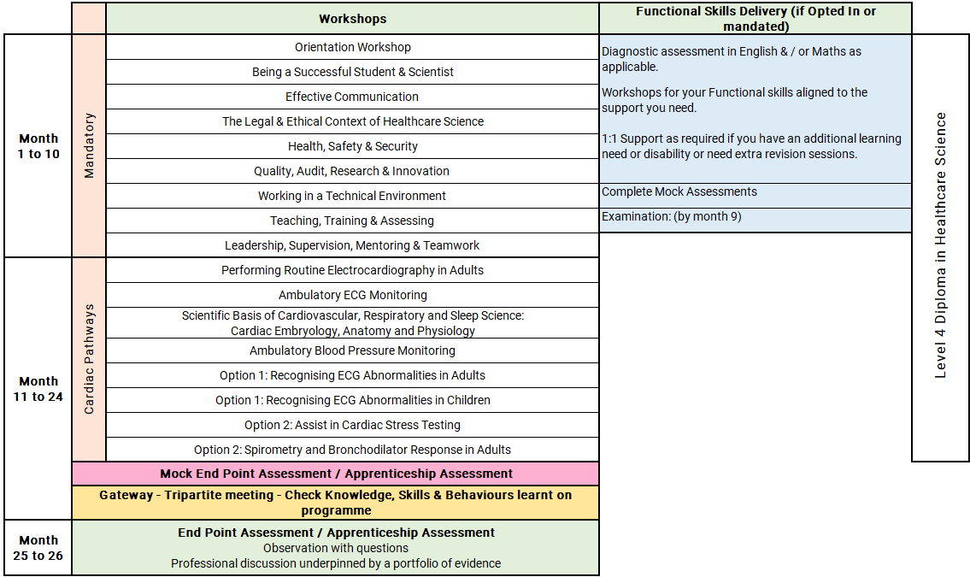
Healthcare Science Associate Level 4: Cardiac
Notes:
Orientation Workshop
Introduction to programme structure, expectations and support.
Using online platforms and digital systems effectively.
Developing good study habits, time management and independent learning skills.
Workshop 2: Being a Successful Student & Scientist (Part 1)
Synopsis:
This session builds on the initial OneFile induction, providing learners with the skills to effectively manage their learning journey. It covers logging journal entries, recording off-the-job training, using the Skills Builder, and navigating Microsoft Teams to support communication and collaboration.
Workshop 3: Effective Communication (Part 2)
Synopsis:
This workshop develops core communication skills, including verbal, non-verbal, and written methods, alongside active listening and feedback. Learners will explore how to overcome communication barriers, deliver effective presentations, and manage challenging situations such as conflict, applying these skills in practical scenarios.
Workshop 4: The Legal & Ethical Context of Healthcare Science (Part 3)
Synopsis:
Learners gain an understanding of the legal, ethical, and professional frameworks underpinning healthcare science. Topics include NHS values, organisational structure, informed consent, professional standards, and the impact of mental health, helping learners apply ethical decision-making in practice.
Workshop 5: Health, Safety & Security (Part 4)
Synopsis:
This session introduces key health and safety principles within the NHS, including legislation, duty of care, safeguarding, and risk management. Learners will explore incident reporting, promoting a no-blame culture, and their role in maintaining a safe working environment.
Workshop 6: Quality, Audit, Research & Innovation (Part 5)
Synopsis:
Learners explore the importance of quality standards, audit processes, research principles, and innovation in healthcare science. The session supports understanding how these elements improve practice and encourages learners to engage with quality improvement and innovation in their workplace.
Workshop 7: Working in a Technical Environment (Part 6)
Synopsis:
This workshop focuses on the role of technical scientific services in patient care. Learners will develop problem-solving skills, understand equipment lifecycle management, and demonstrate safe and effective practice while maintaining professional standards.
Workshop 8: Teaching, Training & Assessing (Part 7)
Synopsis:
Learners are introduced to key teaching and learning theories and how they apply in the workplace. The session covers assessment methods, feedback models, and practical teaching frameworks, enabling learners to support others’ development effectively.
Workshop 9: Leadership, Supervision, Mentoring & Teamwork (Part 8)
Synopsis:
This session develops understanding of leadership and teamwork within healthcare settings. Learners explore leadership models, effective teamworking, mentoring, and supervision, alongside promoting a supportive, no-blame culture in multidisciplinary environments.
Adult –
Unit 134: Performing Routine Electrocardiography in Adults
Develops the knowledge and skills needed to perform routine ECGs
Covers heart structure, function and the relationship to a normal ECG
Explains the principles and features of a normal ECG
Includes safe use of SOPs and clinical protocols
Focuses on effective communication, professionalism and patient dignity
Develops skills in recording routine 12-lead ECGs
Includes checking ECG technical quality and taking corrective action
Covers recognition of life-threatening arrhythmias and appropriate escalation
Unit 54: Ambulatory ECG Monitoring
Covers the principles and limitations of ambulatory ECG monitoring
Explains clinical indications and contraindications for AECG monitoring
Develops skills in preparing, fitting and removing AECG equipment
Includes safe operation and maintenance of AECG systems
Covers monitoring across a range of adult patients
Develops skills in analysing AECG recordings
Includes producing accurate, factual reports
Covers secure and professional patient record keeping
Unit 53: Recognising ECG Abnormalities in Adults
Introduces the principles of electrocardiography and 12-lead ECGs
Explains the strengths and limitations of ECG recordings
Links ECG leads to cardiac anatomy and physiology
Covers electrical and mechanical activity during the cardiac cycle
Explains ECG waves, complexes, segments, intervals and durations
Includes cardiac axis, heart rate calculation and normal adult ranges
Develops recognition of abnormal ECG findings
Covers ECG changes linked to arrhythmias, myocardial infarction, ischaemia, structural heart disease and systemic disorders
Supports accurate factual ECG reporting using appropriate frameworks
Unit 55: Ambulatory Blood Pressure Monitoring
Covers the principles, indications and limitations of ABPM
Explains ABPM equipment and correct use
Includes health and safety, infection control and departmental procedures
Develops skills in setting up, monitoring and removing ABPM devices
Covers interpretation of ABPM recordings
Includes producing factual ABPM reports
Introduces common antihypertensive medications and their relevance
Focuses on professionalism, accuracy, confidentiality and patient data handling
Unit 56: Assist in Cardiac Stress Testing
Explains physiological responses and principles of cardiac stress testing
Covers preparation of equipment, environment and patients
Includes use of SOPs during stress testing procedures
Focuses on communication, compassion and patient support
Develops skills in assisting during testing and recovery phases
Includes infection prevention and equipment decontamination
Supports patient information and follow-up arrangements after investigation
Unit 49: Scientific Basis of Cardiovascular, Respiratory and Sleep Science
Cardiac Embryology, Anatomy and Physiology
Develops understanding of cardiac embryology, anatomy and physiology
Covers stages of cardiac development and congenital heart defects
Explains foetal circulation and changes at birth
Describes heart anatomy, function and major circulations
Covers the cardiac conduction system and cardiac cycle
Links cardiac physiology to the normal ECG
Explains regulation of cardiac output, heart rate and stroke volume
Compares blood vessel structure and function
Explores the impact of vascular disease
Introduces cardiac science investigations and patient-centred care
Supports reflection on teamwork, professional practice and Good Scientific Practice
Paediatrics
Month 10: Unit 134
Performing Routine Electrocardiography in Adults
Develops the knowledge and skills needed to perform routine ECGs
Covers heart structure, function and the relationship to a normal ECG
Explains the principles and features of a normal ECG
Includes use of SOPs and safety protocols
Focuses on communication, professionalism, dignity and confidentiality
Develops skills in recording routine ECGs
Includes checking ECG technical quality and taking corrective action
Covers recognition of life-threatening arrhythmias and appropriate escalation
Month 11: Unit 54
Ambulatory ECG Monitoring
Covers the principles, characteristics and limitations of ambulatory ECG monitoring
Explains clinical indications and contraindications for AECG monitoring
Develops skills in preparing, fitting and removing AECG equipment
Includes safe operation and maintenance of AECG systems
Covers monitoring across a range of adult patients
Develops skills in analysing AECG data
Includes producing accurate, factual reports
Covers secure and professional patient record keeping
Month 12: Unit 58
Recognising ECG Abnormalities in Children
Introduces paediatric electrocardiography
Links cardiac anatomy and physiology to ECG findings in children
Covers normal ECG parameters from infancy to adolescence
Explains developmental variations in paediatric ECGs
Develops recognition of paediatric arrhythmias and cardiac abnormalities
Includes safeguarding and child-friendly care principles
Supports accurate factual reporting of normal and abnormal paediatric ECGs
Month 14: Unit 55
Ambulatory Blood Pressure Monitoring
Covers the principles, indications and limitations of ABPM
Explains ABPM equipment and correct use
Includes health and safety, infection control and departmental procedures
Develops skills in ABPM set-up, monitoring and removal
Covers interpretation of ABPM recordings
Includes producing factual ABPM reports
Introduces common antihypertensive medications and clinical relevance
Focuses on professionalism, accuracy, confidentiality and patient data handling
Month 16: Unit 56
Assist in Cardiac Stress Testing
Explains the principles and physiological responses involved in cardiac stress testing
Covers preparation of equipment, environment and patients
Includes use of SOPs during stress testing procedures
Focuses on communication, compassion and patient support
Develops skills in assisting during testing and recovery phases
Includes infection prevention and equipment decontamination
Supports patient information and follow-up arrangements after investigation
Month 18: Unit 49
Scientific Basis of Cardiovascular, Respiratory and Sleep Science: Cardiac Embryology, Anatomy and Physiology
Develops understanding of cardiac embryology, anatomy and physiology
Covers cardiac development and common congenital heart defects
Explains foetal circulation and changes at birth
Describes heart anatomy, function and major circulations
Covers the cardiac conduction system and cardiac cycle
Links cardiac physiology to the normal ECG
Explains cardiac output, heart rate and stroke volume regulation
Compares blood vessel structure and function
Explores the impact of vascular disease
Introduces cardiac science investigations and patient-centred care
Supports reflection on teamwork, professional practice and Good Scientific Practice
Cardiac with Resp
Unit 134: Performing Routine Electrocardiography in Adults
Develops the knowledge and skills needed to perform routine ECGs
Covers heart structure, function and the relationship to a normal ECG
Explains the principles and features of a normal ECG
Includes use of SOPs and safety protocols
Focuses on communication, professionalism, dignity and confidentiality
Develops skills in recording routine ECGs
Includes checking ECG technical quality and taking corrective action
Covers recognition of life-threatening arrhythmias and appropriate escalation
Unit 54: Ambulatory ECG Monitoring
Covers the principles, characteristics and limitations of ambulatory ECG monitoring
Explains clinical indications and contraindications for AECG monitoring
Develops skills in preparing, fitting and removing AECG equipment
Includes safe operation and maintenance of AECG systems
Covers monitoring across a range of adult patients
Develops skills in analysing AECG data
Includes producing accurate, factual reports
Covers secure and professional patient record keeping
Unit 53: Recognising ECG Abnormalities in Adults
Introduces the principles of electrocardiography and 12-lead ECGs
Explains the strengths and limitations of ECG recordings
Links ECG leads to cardiac anatomy and physiology
Covers electrical and mechanical activity during the cardiac cycle
Explains ECG waves, complexes, segments, intervals and durations
Includes cardiac axis, heart rate calculation and normal adult ranges
Develops recognition of abnormal ECG findings
Covers ECG changes linked to arrhythmias, myocardial infarction, ischaemia, structural heart disease and systemic disorders
Supports accurate factual ECG reporting using appropriate frameworks
Unit 55: Ambulatory Blood Pressure Monitoring
Covers the principles, indications and limitations of ABPM
Explains ABPM equipment and correct use
Includes health and safety, infection control and departmental procedures
Develops skills in ABPM set-up, monitoring and removal
Covers interpretation of ABPM recordings
Includes producing factual ABPM reports
Introduces common antihypertensive medications and clinical relevance
Focuses on professionalism, accuracy, confidentiality and patient data handling
Unit 59: Spirometry and Bronchodilator Response in Adults
Develops knowledge and skills to perform adult spirometry
Covers bronchodilator response testing
Focuses on safe and accurate test performance
Supports interpretation of results
Includes producing technical spirometry reports
Covers equipment maintenance, calibration and quality assurance
Promotes safe, person-centred professional care in practice
Unit 49: Scientific Basis of Cardiovascular, Respiratory and Sleep Science
Cardiac Embryology, Anatomy and Physiology
Develops understanding of cardiac embryology, anatomy and physiology
Covers cardiac development and common congenital heart defects
Explains foetal circulation and changes at birth
Describes heart anatomy, function and major circulations
Covers the cardiac conduction system and cardiac cycle
Links cardiac physiology to the normal ECG
Explains cardiac output, heart rate and stroke volume regulation
Compares blood vessel structure and function
Explores the impact of vascular disease
Introduces cardiac science investigations and patient-centred care
Supports reflection on teamwork, professional practice and Good Scientific Practice

Slide 9
Cardiac: Off-the-Job learning activities include:
Appraisal to be completed and annotated with career plan discussed and developed.
Develop and review different types of communication methods to communicate within your role.
Complete a risk assessment relevant to your area of practice using local procedures.
Produce guidance for a new starter detailing hazardous materials and substances in your workplace and how to manage them safely.
Undertake an innovation or improvement within your workplace.
Participate in drafting at least 2 standard operating procedures within your area of work.
Produce reports demonstrating your understanding and ability to perform Quality Control and Quality Assurance.
Lead a quality management technical audit process, demonstrating your participation in service improvements within your department.
Deliver training and competency assessment to a junior staff member
Pathway specific
Case study reviews of abnormal findings.
Simulation practice:
  ECG recording on mannequins or peer volunteers.
  Simulated ECG recordings and peer assessments.
  Practical ABPM training with simulated patients.
  Observing senior practitioners performing ECGs and reporting, paediatric cardiac clinics, supervised stress testing sessions.
  Participation in clinical skills labs or ECG interpretation sessions.
  CPD sessions on cardiovascular pharmacology and lifestyle modification.
  Tutorials with interactive discussions..
  Mentored review of anonymised AECG recordings.
Attending lectures or webinars on topics like cardiac development and physiology.
Reflective practice – i.e. Keeping logs of observed cases and personal learning outcomes., Critical reflection on challenging ECG interpretations or report writing. Reflective writing on patient communication and safety. Reflective discussion on the role of physiology in diagnosis and patient care.

Slide 10
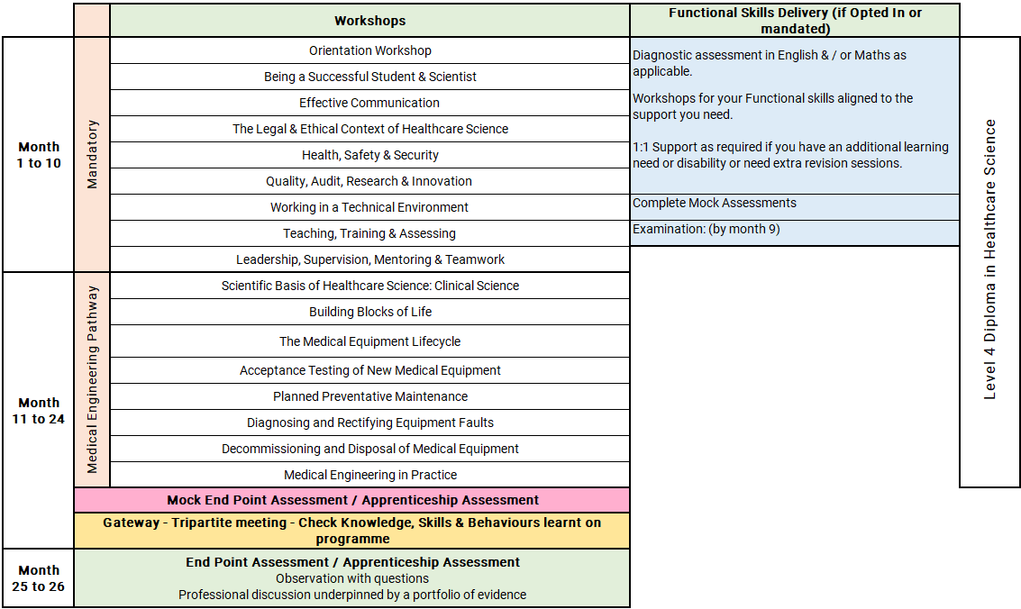
Healthcare Science Associate Level 4: Medical Engineering
Notes:
Orientation Workshop
Introduction to programme structure, expectations and support.
Using online platforms and digital systems effectively.
Developing good study habits, time management and independent learning skills.
Workshop 2: Being a Successful Student & Scientist (Part 1)
Synopsis:
This session builds on the initial OneFile induction, providing learners with the skills to effectively manage their learning journey. It covers logging journal entries, recording off-the-job training, using the Skills Builder, and navigating Microsoft Teams to support communication and collaboration.
Workshop 3: Effective Communication (Part 2)
Synopsis:
This workshop develops core communication skills, including verbal, non-verbal, and written methods, alongside active listening and feedback. Learners will explore how to overcome communication barriers, deliver effective presentations, and manage challenging situations such as conflict, applying these skills in practical scenarios.
Workshop 4: The Legal & Ethical Context of Healthcare Science (Part 3)
Synopsis:
Learners gain an understanding of the legal, ethical, and professional frameworks underpinning healthcare science. Topics include NHS values, organisational structure, informed consent, professional standards, and the impact of mental health, helping learners apply ethical decision-making in practice.
Workshop 5: Health, Safety & Security (Part 4)
Synopsis:
This session introduces key health and safety principles within the NHS, including legislation, duty of care, safeguarding, and risk management. Learners will explore incident reporting, promoting a no-blame culture, and their role in maintaining a safe working environment.
Workshop 6: Quality, Audit, Research & Innovation (Part 5)
Synopsis:
Learners explore the importance of quality standards, audit processes, research principles, and innovation in healthcare science. The session supports understanding how these elements improve practice and encourages learners to engage with quality improvement and innovation in their workplace.
Workshop 7: Working in a Technical Environment (Part 6)
Synopsis:
This workshop focuses on the role of technical scientific services in patient care. Learners will develop problem-solving skills, understand equipment lifecycle management, and demonstrate safe and effective practice while maintaining professional standards.
Workshop 8: Teaching, Training & Assessing (Part 7)
Synopsis:
Learners are introduced to key teaching and learning theories and how they apply in the workplace. The session covers assessment methods, feedback models, and practical teaching frameworks, enabling learners to support others’ development effectively.
Workshop 9: Leadership, Supervision, Mentoring & Teamwork (Part 8)
Synopsis:
This session develops understanding of leadership and teamwork within healthcare settings. Learners explore leadership models, effective teamworking, mentoring, and supervision, alongside promoting a supportive, no-blame culture in multidisciplinary environments.
Units 11 & 17: Scientific Basis of Healthcare Science and Building Blocks of Life
Delivered as a combined unit
Duration: 4 months
Delivered through a blended learning approach
Uses online classroom activities, self-study and the ATOM virtual learning platform
Explores anatomy, physiology and pathology of the major body systems
Covers classification, structure and function of cells and tissues
Introduces genetics, including genes, chromosomes, DNA and the human genome
Covers carbohydrates, lipids and amino acids
Explains the role of proteins in biological systems
Explores chemical, cellular and tissue organisation of the body
Links body systems to disease and their effects
Introduces sociology of health and disease
Units 108–113: Medical Engineering Workshop Practice
Units covered
Unit 108: The Medical Equipment Lifecycle
Unit 109: Acceptance Testing of New Medical Equipment
Unit 110: Planned Preventative Maintenance
Unit 111: Diagnosing and Rectifying Equipment Faults
Unit 112: Decommissioning and Disposal of Medical Equipment
Unit 113: Medical Engineering in Practice
Session synopsis
Duration: 4 months
Develops knowledge, skills, experience and professional attitudes for working in a medical engineering workshop
Primarily delivered through work-based activities
Focuses on safe and effective practice within a workshop setting
Covers the full medical equipment lifecycle
Includes acceptance testing of new equipment
Develops understanding of planned preventative maintenance
Supports skills in diagnosing and rectifying equipment faults
Covers safe decommissioning and disposal of medical equipment
Builds professional practice in medical engineering
Learners gather evidence of competence, such as:
competency records
maintenance logs
daily checklists
witness testimonies
evidence of further departmental training

Slide 11
Medical Engineering: Off-the-Job learning activities include:
Appraisal to be completed and annotated with career plan discussed and developed.
Develop and review different types of communication methods to communicate within your role.
Complete a risk assessment relevant to your area of practice using local procedures.
Produce guidance for a new starter detailing hazardous materials and substances in your workplace and how to manage them safely.
Undertake an innovation or improvement within your workplace.
Participate in drafting at least 2 standard operating procedures within your area of work.
Produce reports demonstrating your understanding and ability to perform Quality Control and Quality Assurance.
Lead a quality management technical audit process, demonstrating your participation in service improvements within your department.
Deliver training and competency assessment to a junior staff member
Pathway Specific
Learners will complete weekly anatomy and physiology e-learning via ATOM software.
Learners will attend three taught sessions covering A&P introduction, sociology, and genetics.
Learners will have monthly 2-hour check-ins with their coach.
Learners should complete their assessments and knowledge workbooks for the units.
Attending a Multi-Disciplinary Team Meeting (MDM/MDT) where a patient’s pathway is discussed using diagnostic tests.
Spending time with the Patient Liaison Service to understand how queries and complaints are managed.
Attending a Comorbidity Meeting to discuss unexpected or unexplained patient deaths, including root cause analysis.
Understanding the wider patient journey by observing the use of equipment in clinical areas and its role in patient care.
Attending Trust/Organisational Quality Meetings to review data related to medical devices.

Slide 12
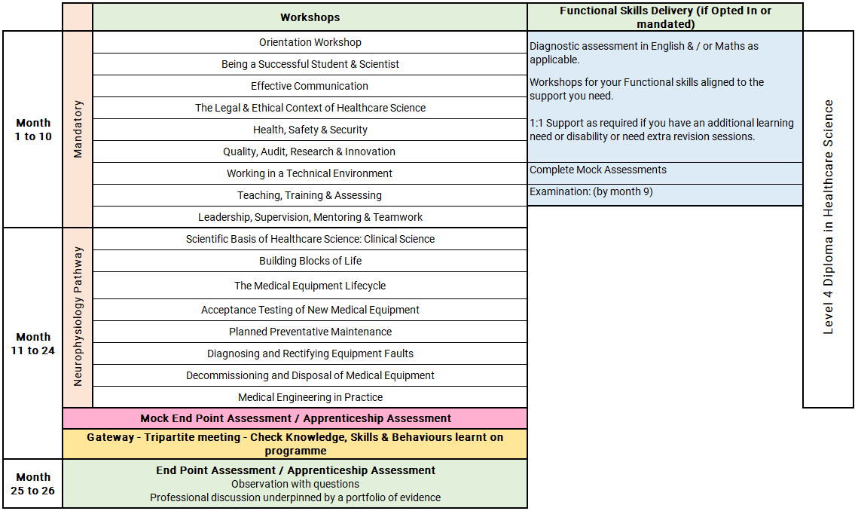
Healthcare Science Associate Level 4: Neurophysiology
Notes:
Orientation Workshop
Introduction to programme structure, expectations and support.
Using online platforms and digital systems effectively.
Developing good study habits, time management and independent learning skills.
Workshop 2: Being a Successful Student & Scientist (Part 1)
Synopsis:
This session builds on the initial OneFile induction, providing learners with the skills to effectively manage their learning journey. It covers logging journal entries, recording off-the-job training, using the Skills Builder, and navigating Microsoft Teams to support communication and collaboration.
Workshop 3: Effective Communication (Part 2)
Synopsis:
This workshop develops core communication skills, including verbal, non-verbal, and written methods, alongside active listening and feedback. Learners will explore how to overcome communication barriers, deliver effective presentations, and manage challenging situations such as conflict, applying these skills in practical scenarios.
Workshop 4: The Legal & Ethical Context of Healthcare Science (Part 3)
Synopsis:
Learners gain an understanding of the legal, ethical, and professional frameworks underpinning healthcare science. Topics include NHS values, organisational structure, informed consent, professional standards, and the impact of mental health, helping learners apply ethical decision-making in practice.
Workshop 5: Health, Safety & Security (Part 4)
Synopsis:
This session introduces key health and safety principles within the NHS, including legislation, duty of care, safeguarding, and risk management. Learners will explore incident reporting, promoting a no-blame culture, and their role in maintaining a safe working environment.
Workshop 6: Quality, Audit, Research & Innovation (Part 5)
Synopsis:
Learners explore the importance of quality standards, audit processes, research principles, and innovation in healthcare science. The session supports understanding how these elements improve practice and encourages learners to engage with quality improvement and innovation in their workplace.
Workshop 7: Working in a Technical Environment (Part 6)
Synopsis:
This workshop focuses on the role of technical scientific services in patient care. Learners will develop problem-solving skills, understand equipment lifecycle management, and demonstrate safe and effective practice while maintaining professional standards.
Workshop 8: Teaching, Training & Assessing (Part 7)
Synopsis:
Learners are introduced to key teaching and learning theories and how they apply in the workplace. The session covers assessment methods, feedback models, and practical teaching frameworks, enabling learners to support others’ development effectively.
Workshop 9: Leadership, Supervision, Mentoring & Teamwork (Part 8)
Synopsis:
This session develops understanding of leadership and teamwork within healthcare settings. Learners explore leadership models, effective teamworking, mentoring, and supervision, alongside promoting a supportive, no-blame culture in multidisciplinary environments.
Units 11 & 17: Scientific Basis of Healthcare Science and Building Blocks of Life
Delivered as a combined unit
Duration: 4 months
Delivered through a blended learning approach
Uses online classroom activities, self-study and the ATOM virtual learning platform
Explores anatomy, physiology and pathology of the major body systems
Covers classification, structure and function of cells and tissues
Introduces genetics, including genes, chromosomes, DNA and the human genome
Covers carbohydrates, lipids and amino acids
Explains the role of proteins in biological systems
Explores chemical, cellular and tissue organisation of the body
Links body systems to disease and their effects
Introduces sociology of health and disease
Assessment method
Sociology Knowledge Workbook
Genetics Knowledge Workbook
Digestion Knowledge Workbook
Cells and Tissue Knowledge Workbook
Reflective diary after each taught session
Sociology professional discussion/presentation based on a mental health case study
GoReact evidence capture for professional discussion
Written case study on a disease linked to a body system
Unit 15: Scientific Basis of Healthcare Science
Maths, Statistics and Physical Sciences
Duration: 1 month
Introduces mathematics, statistics and physical sciences in healthcare science
Focuses on investigation and data analysis within healthcare settings
Covers basic statistical methods using anonymised data
Includes presenting numerical and graphical data to a team
Develops skills in plotting quality control data
Supports interpretation of trends and outliers
Covers basic physics and clinical engineering principles
Delivered across three taught sessions
Assessment method
Unit 15 Maths and Stats Workbook
Unit 15 Physics Workbook
Statistics presentation on statistics in healthcare
Numerical and graphical presentation of data
Professional discussion on physics and engineering in healthcare science services
GoReact evidence capture for professional discussion
Reflective report on an incident involving measurement or calculation error
Unit 68: Assisting with Electroencephalography
Duration: 2 months
Develops knowledge, skills, experience and professional attitudes for clinical practice
Primarily delivered through work-based activities
Focuses on safe practice within a clinical setting
Supports learners to assist with electroencephalography procedures
Builds workplace confidence and clinical competence
Learners gather evidence of work-based competence, such as:
competency records
maintenance logs
daily checklists
witness testimonies
evidence of further departmental training
Assessment method
Work-based competency evidence
Competency records
Maintenance logs
Daily checklists
Witness testimonies
Evidence of further training within the department

Slide 13
Neurophysiology: Off-the-Job learning activities include:
Appraisal to be completed and annotated with career plan discussed and developed.
Develop and review different types of communication methods to communicate within your role.
Complete a risk assessment relevant to your area of practice using local procedures.
Produce guidance for a new starter detailing hazardous materials and substances in your workplace and how to manage them safely.
Undertake an innovation or improvement within your workplace.
Participate in drafting at least 2 standard operating procedures within your area of work.
Produce reports demonstrating your understanding and ability to perform Quality Control and Quality Assurance.
Lead a quality management technical audit process, demonstrating your participation in service improvements within your department.
Deliver training and competency assessment to a junior staff member
Pathway
Learners will complete weekly anatomy and physiology e-learning via ATOM software.
Learners will have continuous check-ins with their coach every month for 2 hours.
Learners should complete their assessments for these units as well as the knowledge workbooks.
Learners will attend a Quality Meeting where statistics and data are discussed.
Attending a Multi-Disciplinary Team Meeting (MDM/MDT) where a patient’s pathway is discussed using diagnostic tests.
Spending time with the Patient Liaison Service to see how they manage queries and complaints.
Attending a Comorbidity Meeting to discuss unexpected or unexplained patient deaths, including root cause analysis.
Seeing patients in clinic with a Clinician to discuss diagnosis and plan treatments.
Reflective accounts for all OTJ activities to highlight learning and demonstrate career progression opportunities.

Slide 14
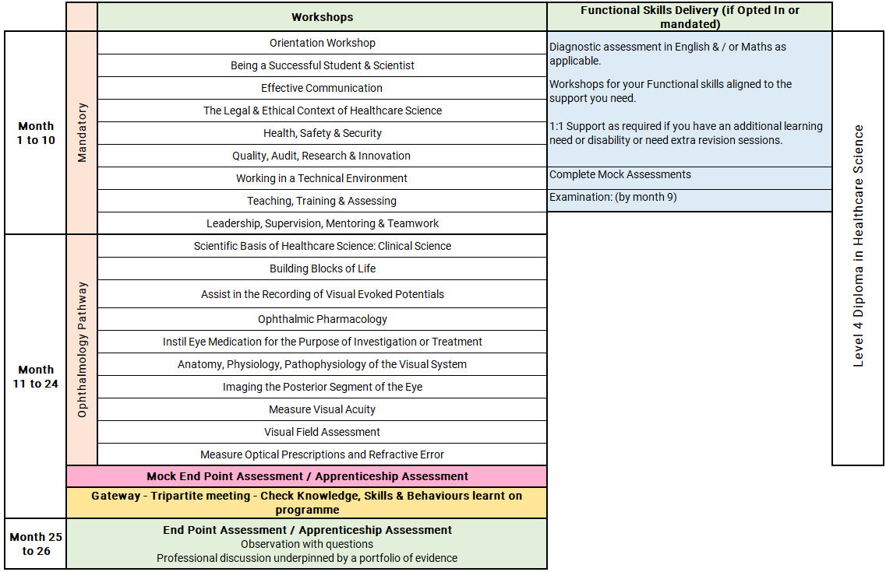
Healthcare Science Associate Level 4: Ophthalmology
Notes:
Orientation Workshop
Introduction to programme structure, expectations and support.
Using online platforms and digital systems effectively.
Developing good study habits, time management and independent learning skills.
Workshop 2: Being a Successful Student & Scientist (Part 1)
Synopsis:
This session builds on the initial OneFile induction, providing learners with the skills to effectively manage their learning journey. It covers logging journal entries, recording off-the-job training, using the Skills Builder, and navigating Microsoft Teams to support communication and collaboration.
Workshop 3: Effective Communication (Part 2)
Synopsis:
This workshop develops core communication skills, including verbal, non-verbal, and written methods, alongside active listening and feedback. Learners will explore how to overcome communication barriers, deliver effective presentations, and manage challenging situations such as conflict, applying these skills in practical scenarios.
Workshop 4: The Legal & Ethical Context of Healthcare Science (Part 3)
Synopsis:
Learners gain an understanding of the legal, ethical, and professional frameworks underpinning healthcare science. Topics include NHS values, organisational structure, informed consent, professional standards, and the impact of mental health, helping learners apply ethical decision-making in practice.
Workshop 5: Health, Safety & Security (Part 4)
Synopsis:
This session introduces key health and safety principles within the NHS, including legislation, duty of care, safeguarding, and risk management. Learners will explore incident reporting, promoting a no-blame culture, and their role in maintaining a safe working environment.
Workshop 6: Quality, Audit, Research & Innovation (Part 5)
Synopsis:
Learners explore the importance of quality standards, audit processes, research principles, and innovation in healthcare science. The session supports understanding how these elements improve practice and encourages learners to engage with quality improvement and innovation in their workplace.
Workshop 7: Working in a Technical Environment (Part 6)
Synopsis:
This workshop focuses on the role of technical scientific services in patient care. Learners will develop problem-solving skills, understand equipment lifecycle management, and demonstrate safe and effective practice while maintaining professional standards.
Workshop 8: Teaching, Training & Assessing (Part 7)
Synopsis:
Learners are introduced to key teaching and learning theories and how they apply in the workplace. The session covers assessment methods, feedback models, and practical teaching frameworks, enabling learners to support others’ development effectively.
Workshop 9: Leadership, Supervision, Mentoring & Teamwork (Part 8)
Synopsis:
This session develops understanding of leadership and teamwork within healthcare settings. Learners explore leadership models, effective teamworking, mentoring, and supervision, alongside promoting a supportive, no-blame culture in multidisciplinary environments.
Units 11 & 17: Scientific Basis of Healthcare Science and Building Blocks of Life
Delivered as a combined unit
Duration: 4 months
Delivered through a blended learning approach
Uses online classroom activities, self-study and the ATOM virtual learning platform
Explores anatomy, physiology and pathology of the major body systems
Covers classification, structure and function of cells and tissues
Introduces genetics, including genes, chromosomes, DNA and the human genome
Covers carbohydrates, lipids and amino acids
Explains the role of proteins in biological systems
Explores chemical, cellular and tissue organisation of the body
Links body systems to disease and their effects
Introduces sociology of health and disease

Slide 15
Ophthalmology: Off-the-Job learning activities include:
Appraisal to be completed and annotated with career plan discussed and developed.
Develop and review different types of communication methods to communicate within your role.
Complete a risk assessment relevant to your area of practice using local procedures.
Produce guidance for a new starter detailing hazardous materials and substances in your workplace and how to manage them safely.
Undertake an innovation or improvement within your workplace.
Participate in drafting at least 2 standard operating procedures within your area of work.
Produce reports demonstrating your understanding and ability to perform Quality Control and Quality Assurance.
Lead a quality management technical audit process, demonstrating your participation in service improvements within your department.
Deliver training and competency assessment to a junior staff member
Pathway Specific
Understanding the wider patient journey by attending a Multi-Disciplinary Team Meeting (MDM/MDT) where a patient’s pathway is being discussed using diagnostic tests.
Seeing patients in clinic with a Clinician to discuss diagnosis and plan treatments.
Opportunities to observe corrective procedures for patients, such as small surgeries, cataract operations, or lens replacements.
Learners will complete weekly anatomy and physiology e-learning via ATOM software.
Learners will attend three taught sessions covering A&P introduction, sociology, and genetics.
Spending time with the Patient Liaison Service to see how they manage queries and complaints.
Attending a Comorbidity Meeting where unexpected or unexplained patient deaths are discussed, including root cause analysis.
Reflective accounts for all OTJ activities to highlight learning and demonstrate career progression opportunities.

Slide 16
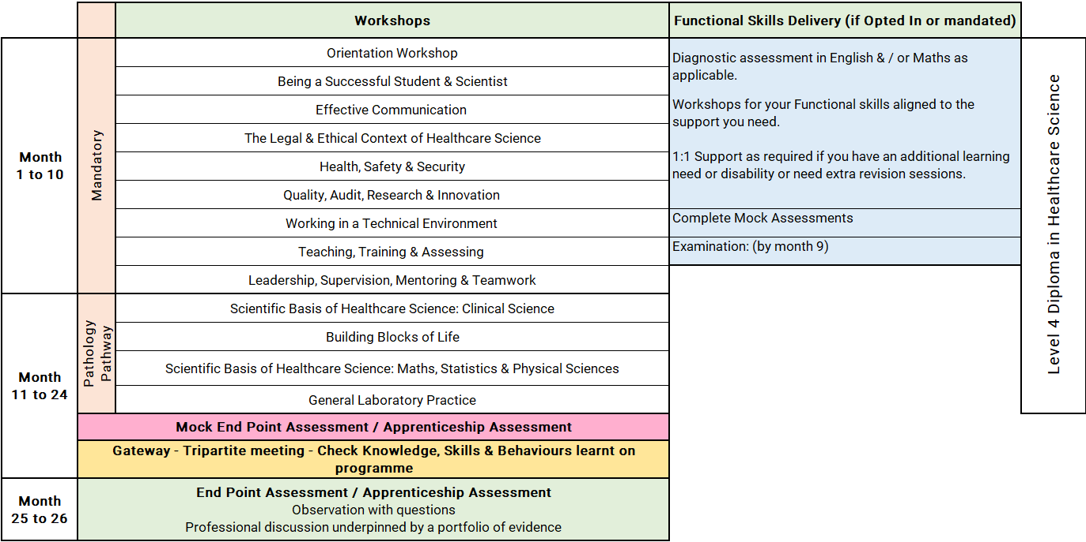
Healthcare Science Associate Level 4: Pathology
Notes:
Orientation Workshop
Introduction to programme structure, expectations and support.
Using online platforms and digital systems effectively.
Developing good study habits, time management and independent learning skills.
Workshop 2: Being a Successful Student & Scientist (Part 1)
Synopsis:
This session builds on the initial OneFile induction, providing learners with the skills to effectively manage their learning journey. It covers logging journal entries, recording off-the-job training, using the Skills Builder, and navigating Microsoft Teams to support communication and collaboration.
Workshop 3: Effective Communication (Part 2)
Synopsis:
This workshop develops core communication skills, including verbal, non-verbal, and written methods, alongside active listening and feedback. Learners will explore how to overcome communication barriers, deliver effective presentations, and manage challenging situations such as conflict, applying these skills in practical scenarios.
Workshop 4: The Legal & Ethical Context of Healthcare Science (Part 3)
Synopsis:
Learners gain an understanding of the legal, ethical, and professional frameworks underpinning healthcare science. Topics include NHS values, organisational structure, informed consent, professional standards, and the impact of mental health, helping learners apply ethical decision-making in practice.
Workshop 5: Health, Safety & Security (Part 4)
Synopsis:
This session introduces key health and safety principles within the NHS, including legislation, duty of care, safeguarding, and risk management. Learners will explore incident reporting, promoting a no-blame culture, and their role in maintaining a safe working environment.
Workshop 6: Quality, Audit, Research & Innovation (Part 5)
Synopsis:
Learners explore the importance of quality standards, audit processes, research principles, and innovation in healthcare science. The session supports understanding how these elements improve practice and encourages learners to engage with quality improvement and innovation in their workplace.
Workshop 7: Working in a Technical Environment (Part 6)
Synopsis:
This workshop focuses on the role of technical scientific services in patient care. Learners will develop problem-solving skills, understand equipment lifecycle management, and demonstrate safe and effective practice while maintaining professional standards.
Workshop 8: Teaching, Training & Assessing (Part 7)
Synopsis:
Learners are introduced to key teaching and learning theories and how they apply in the workplace. The session covers assessment methods, feedback models, and practical teaching frameworks, enabling learners to support others’ development effectively.
Workshop 9: Leadership, Supervision, Mentoring & Teamwork (Part 8)
Synopsis:
This session develops understanding of leadership and teamwork within healthcare settings. Learners explore leadership models, effective teamworking, mentoring, and supervision, alongside promoting a supportive, no-blame culture in multidisciplinary environments.
Units 11 & 17: Scientific Basis of Healthcare Science and Building Blocks of Life
Delivered as a combined unit
Duration: 4 months
Delivered through a blended learning approach
Uses online classroom activities, self-study and the ATOM virtual learning platform
Explores anatomy, physiology and pathology of the major body systems
Covers classification, structure and function of cells and tissues
Introduces genetics, including genes, chromosomes, DNA and the human genome
Covers carbohydrates, lipids and amino acids
Explains the role of proteins in biological systems
Explores chemical, cellular and tissue organisation of the body
Links body systems to disease and their effects
Introduces sociology of health and disease

Slide 17
Pathology: Off-the-Job learning activities include:
Appraisal to be completed and annotated with career plan discussed and developed.
Develop and review different types of communication methods to communicate within your role.
Complete a risk assessment relevant to your area of practice using local procedures.
Produce guidance for a new starter detailing hazardous materials and substances in your workplace and how to manage them safely.
Undertake an innovation or improvement within your workplace.
Participate in drafting at least 2 standard operating procedures within your area of work.
Produce reports demonstrating your understanding and ability to perform Quality Control and Quality Assurance.
Lead a quality management technical audit process, demonstrating your participation in service improvements within your department.
Deliver training and competency assessment to a junior staff member
Pathway Specific
Learners will complete weekly anatomy and physiology e-learning via Atom.
Learners will provide a reflective account after each taught session, describing what they have learned and how to apply the knowledge to their working practice.
Learners will select a disease affecting multiple body systems and produce a case study covering this.
Work-based activities relating to anatomy and physiology, including:
  Shadowing clinicians in the histopathology laboratory to observe tissue dissection and anatomy.
  Shadowing a clinical scientist/clinician in patient clinics related to fields such as cytology, biochemistry, haematology, or microbiology, and writing reflections on the experience.
Completing a presentation on a scientific topic of the learner's choice, discussing statistics and data presentation methods.
Participating in plotting QC data (e.g., Levey-Jennings charts) and interpreting trends or outliers.
Reviewing a lab incident involving measurement or calculation errors and writing a reflective report on how it could be prevented.

Slide 18
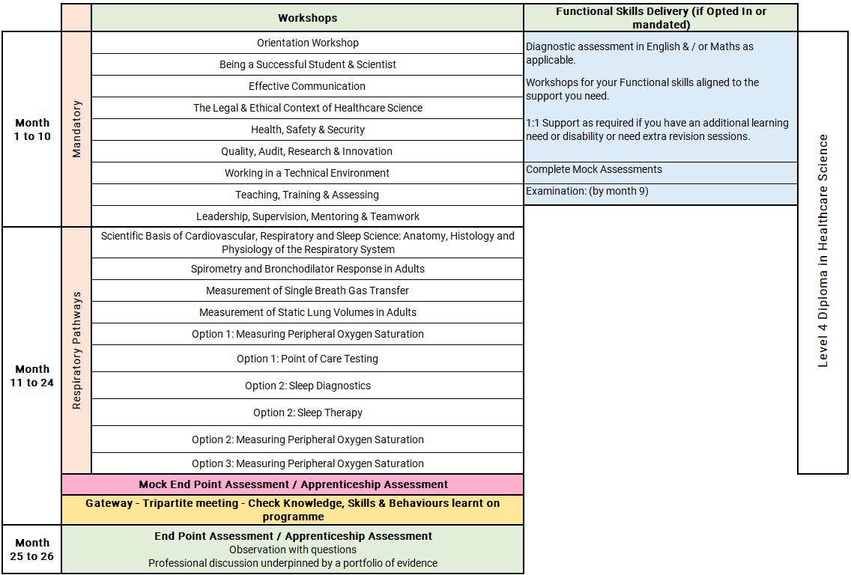
Healthcare Science Associate Level 4: Respiratory
Notes:
Orientation Workshop
Introduction to programme structure, expectations and support.
Using online platforms and digital systems effectively.
Developing good study habits, time management and independent learning skills.
Workshop 2: Being a Successful Student & Scientist (Part 1)
Synopsis:
This session builds on the initial OneFile induction, providing learners with the skills to effectively manage their learning journey. It covers logging journal entries, recording off-the-job training, using the Skills Builder, and navigating Microsoft Teams to support communication and collaboration.
Workshop 3: Effective Communication (Part 2)
Synopsis:
This workshop develops core communication skills, including verbal, non-verbal, and written methods, alongside active listening and feedback. Learners will explore how to overcome communication barriers, deliver effective presentations, and manage challenging situations such as conflict, applying these skills in practical scenarios.
Workshop 4: The Legal & Ethical Context of Healthcare Science (Part 3)
Synopsis:
Learners gain an understanding of the legal, ethical, and professional frameworks underpinning healthcare science. Topics include NHS values, organisational structure, informed consent, professional standards, and the impact of mental health, helping learners apply ethical decision-making in practice.
Workshop 5: Health, Safety & Security (Part 4)
Synopsis:
This session introduces key health and safety principles within the NHS, including legislation, duty of care, safeguarding, and risk management. Learners will explore incident reporting, promoting a no-blame culture, and their role in maintaining a safe working environment.
Workshop 6: Quality, Audit, Research & Innovation (Part 5)
Synopsis:
Learners explore the importance of quality standards, audit processes, research principles, and innovation in healthcare science. The session supports understanding how these elements improve practice and encourages learners to engage with quality improvement and innovation in their workplace.
Workshop 7: Working in a Technical Environment (Part 6)
Synopsis:
This workshop focuses on the role of technical scientific services in patient care. Learners will develop problem-solving skills, understand equipment lifecycle management, and demonstrate safe and effective practice while maintaining professional standards.
Workshop 8: Teaching, Training & Assessing (Part 7)
Synopsis:
Learners are introduced to key teaching and learning theories and how they apply in the workplace. The session covers assessment methods, feedback models, and practical teaching frameworks, enabling learners to support others’ development effectively.
Workshop 9: Leadership, Supervision, Mentoring & Teamwork (Part 8)
Synopsis:
This session develops understanding of leadership and teamwork within healthcare settings. Learners explore leadership models, effective teamworking, mentoring, and supervision, alongside promoting a supportive, no-blame culture in multidisciplinary environments.
Unit 50: Scientific Basis of Cardiovascular, Respiratory and Sleep Science
Anatomy, Histology and Physiology of the Respiratory System
Develops theoretical knowledge of the respiratory system
Covers respiratory anatomy, histology and physiology
Provides a foundation for further study in respiratory and sleep science
Explores the mechanisms of respiration and gas exchange
Links theoretical knowledge to routine technical skills in respiratory science
Supports development of professional behaviours aligned with Good Scientific Practice
Unit 59: Spirometry and Bronchodilator Response in Adults
Develops knowledge and skills to perform spirometry in adults
Covers bronchodilator response testing
Focuses on safe, accurate and quality-assured testing
Supports interpretation of spirometry results
Includes contribution to technical report generation
Covers equipment maintenance, calibration and quality assurance procedures
Promotes safe, person-centred professional care in practice
Unit 60: Measurement of Single Breath Gas Transfer
Develops competence in performing single breath gas transfer testing
Focuses on safe, accurate and quality-assured measurement
Supports interpretation of technical data
Includes contribution to technical reporting
Covers equipment maintenance, calibration and quality assurance procedures
Promotes safe and person-centred care during testing

Slide 19
Respiratory: Off-the-Job learning activities include:
Appraisal to be completed and annotated with career plan discussed and developed.
Develop and review different types of communication methods to communicate within your role.
Complete a risk assessment relevant to your area of practice using local procedures.
Produce guidance for a new starter detailing hazardous materials and substances in your workplace and how to manage them safely.
Undertake an innovation or improvement within your workplace.
Participate in drafting at least 2 standard operating procedures within your area of work.
Produce reports demonstrating your understanding and ability to perform Quality Control and Quality Assurance.
Lead a quality management technical audit process, demonstrating your participation in service improvements within your department.
Deliver training and competency assessment to a junior staff member
Pathway Specific
Shadow a respiratory physiologist or sleep technician during procedures (e.g., spirometry, CPAP titration). Write a reflective log linking observations to theory.
Review anonymized case studies of respiratory conditions (e.g., COPD, asthma). Present findings in a report or presentation.
Reflect on tutorials and describe how learning will be applied in practice.
Practice spirometry and bronchodilator response skills. Complete ARTP competency assessments with supervisor support.
Practice single breath gas transfer skills. Complete ARTP competency assessments with supervisor guidance.
Practice static lung volume measurement skills. Complete ARTP competency assessments with supervisor guidance.
Practice measuring peripheral oxygen saturation. Complete a logbook and demonstrate ECG competency.
Practice point-of-care testing. Gain competency with supervisor support and log hours for shadowing and sign-off.
Notes:
Pathway Specific
Practice managing sleep apnoea using CPAP therapy. Complete ARTP competency assessments with supervisor guidance.
Deliver presentations on spirometry, respiratory disease patterns, and sleep disorders. Include data interpretation.
Review a lab incident involving calculation errors. Write a reflective report on prevention strategies.
Create a photo diary demonstrating sleep diagnostics with two different devices.

Slide 20
Progression Opportunities
On successful completion of the programme, participants may:
Professional Registration: Upon completion, assistants are eligible to apply to join the Academy for Healthcare Science (AHCS) accredited register.
Into specialists roles relevant to your future role pathways
Participants may also progress to:
Level 4 Healthcare Science Associate Programmes and their chosen pathways
Other internal CPD opportunities

Slide 21
Apprenticeships: What You Need to Know
An apprenticeship is a work-based learning programme
Developed by employers from the sector
Funded through the apprenticeship Levy
Suitable for new entrants and existing staff developing their careers.
An apprenticeship consists of:
An apprenticeship is a work-based learning programme
Knowledge of the areas involved in the staff's role at the appropriate level
Skills the learner is expected to demonstrate competently
An option to upskilling in maths and English and achievement of functional skills (if not mandated)
Achievement of Diploma or other requirement subject to the needs of the apprenticeship standard

Slide 22
The Apprenticeship Journey
Application
On
Programme
Assessment
Gateway
EPA / Apprenticeship Assessment
(example)
Completion
Observation in practice
Information
Off the job training
Preparation for assessment
Achievement
Application & eligibility check
Multiple choice exam
Standard/Diploma
/Other
Evidence of programme achievement 100%
Certification
Assessments & induction
Reflective journal and interview
English & maths opt in
Ready for EPA/ Apprenticeship Assessment
Progression

Slide 23







Apprenticeship Support
Learning Support Assistant
Skills & Development Coach
Employer including: Line Manager /Mentor
Functional Skills Tutor
Supported employment service Job Coach
Apprentice / Learner
Apprenticeship Assessment Organisation

Slide 24
Reasonable adjustments to learning and assessment
Reasonable adjustments can be made for example:
Extra time allowance
Assistive technology
Alternative assessment methods
British sign language interpreter
Timed rest breaks
121 support
Increased support.

Slide 25
Understanding Functional Skills
Notes:
Apprentices with an undiagnosed learning difficulty or disability may be able to access this flexibility by completing a detailed assessment with our specialist coach.

Slide 26
Dedicated Learning Time
Teaching & Learning Reviews
⏱ 2 hours (every 4–6 weeks)
• In person or online
• Learner meets with Coach
• Feedback shared with Line Manager / Workplace Mentor
Online Workshops (MS Teams)
📅 Approx. monthly
• Full‑day workshops
• Aligned to the apprenticeship standard
• Dates confirmed at programme start
10 –12 Week Progress Reviews
⏱ 90 minutes
• Three‑way review: Coach, Learner, Line Manager / Mentor
• Review progress, impact of learning and next steps
Independent Learning /
Study Time
⏱ Weekly commitment
• Minimum half a day per week
• 1–2 hours focused work‑based learning
Notes:
Responsibilities
The Apprentice
Complete work meeting targets set
Attend any training sessions made available
Communicate clearly and regularly with Tutor
Commence Functional Skills from the beginning of their programme if required to complete
Complete and record off-the-Job activity every month
Independent learning / time for study – reading, watching developmental videos, research tasks and projects
Line Manager/Mentor
Support development of the learner, giving opportunity to practice new skills attained in the workplace
Allow the learner to attend all agreed Tutor sessions and allow protected time for reflection and written work
Support with off-the-job learning identification and recording
Attend progress reviews
In work learning opportunities – Shadowing, stepping up, coaching, mentoring
Dynamic Training
Create an individual learning plan
Identify any recognition of prior learning
Provide quality training, support and assessment
Provide regular feedback and development opportunities
Adapt delivery and assessment to meet individual needs where applicable

Slide 27






E-learning Tools
The tools learners use to support achievement of their apprenticeship programme

Slide 28

UCAS Points
Individuals completing apprenticeships may be awarded up to 112 UCAS points, depending on the length of their apprenticeship.
Apprentices must pass their end-point assessment / Apprenticeship Assessment to utilise these points for university applications (including higher, degree level apprenticeship programmes)
Notes:
Length is duration planned not how long the programme takes to achieve. i.e. if a learner achieves earlier they get the planned duration UCAs tariff points.

Slide 29
Employer Grants & Incentives
£1,000 — Young Apprentice Incentive
Employers can receive £1,000 for taking on an apprentice aged 16 to 18 years old, or aged 19 to 24 years old with an Education, Health and Care Plan, or who is a care leaver.
Employer eligibility: All sizes of employer
Availability: Available now
£2,000 — Non-Levy Jobs Grant
From October 2026, employers that do not pay the apprenticeship levy could receive up to £2,000 for hiring an apprentice aged 16 to 24, and new employees within the previous 3 months.
Employer eligibility: Only for non-levy employers
Availability: Available from October 2026
£3,000 — Youth Jobs Grant
Businesses can receive £3,000 for hiring an individual aged 18 to 24 who has been receiving Universal Credit and looking for work for six months or more.
Employer eligibility: All sizes of employer
Availability: Available now
£2,000 — Foundation Apprenticeship Incentive
Employers offering Foundation Apprenticeships to young people aged 16 to 21, or eligible 22 to 24 year olds, can receive up to £2,000.
Payments support progression to a further apprenticeship.
Employer eligibility: All sizes of employer
Availability: Available now

Slide 30
Additional Incentives
National Insurance Contributions
Employers do not pay National Insurance Contributions for apprentices aged under 25 years, or for any employee aged 21 or below, if salary is below £50,270.
Rate referenced: 2025/26 rate
Funding for Under 25s
Non-levy employers do not pay training costs for apprentices aged under 25.
For those aged 25+, the cost is 5%, or zero if using a levy transfer.
Care Leavers’ Bursary
Eligible apprentices aged 18 to 24 can receive an additional £3,000 from government, in addition to their salary.
This payment is tax free.
Employers may be able to access multiple incentives for the same young person where eligibility criteria are met.

Slide 31
Questions for Reflection
How would this benefit me?
Would I be able to commit?
What other commitments do I currently have?
Would my department support this?
What would I need from my employer to support me?

Slide 32
Next Steps
Make an informed decision if the apprenticeship programme is right for you?
If yes!
Follow your companies expression of Interest process to start the enrolment process or
Email us and we will contact your employer direct – ask.dynamic@dynamictraining.org.uk
Find out more about the programmes via our website www.dynamictraining.org.uk
Speak to one our team to answer your questions via email ask.dynamic@dynamictraining.org.uk or call 0208 607 7850

