Slide 1

Safeguarding Support Officer Level 3 Apprenticeship.

Slide 2
Who are Dynamic Training
Established in 2007
Centres in Uxbridge and Hartlepool
Delivering
Apprenticeships
&
Bespoke Training Solutions
Supporting circa 500 learners on a variety of programmes at any one time
Over 80 NHS Trusts choose Dynamic Training with their ongoing Learning & Development Needs
Matrix Accredited.
A Skills for Care Endorsed provider.
A disability confident employer
Part of Calder Holding BV
13 companies with 1000+ employees in the UK and the Netherlands.
Retained our Ofsted “good” inspection grade in June 2025

Slide 3
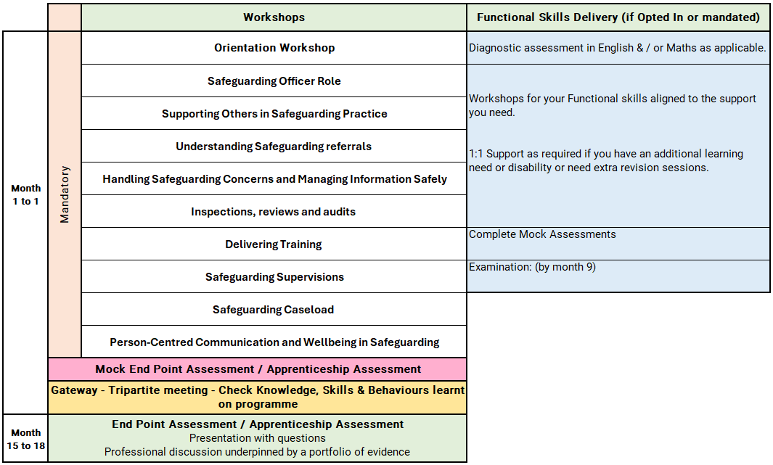
Safeguarding Support Officer Level 3 Apprenticeship
Notes:
Orientation Workshop
Introduction to programme structure, expectations and support.
Using online platforms and digital systems effectively.
Developing good study habits, time management and independent learning skills.
Safeguarding Workshops Overview
Safeguarding Officer Role
Builds foundational knowledge of safeguarding principles, legislation, and organisational protocols, enabling learners to recognise, respond to, and manage safeguarding concerns within their role.
Supporting Others in Safeguarding Practice
Focuses on developing the ability to advise, guide, and support colleagues, while confidently delivering safeguarding training using a range of effective teaching methods.
Understanding Safeguarding Referrals
Develops understanding of different types of concerns, escalation pathways, and how to complete accurate, high-quality referrals to appropriate safeguarding services.
Handling Safeguarding Concerns and Managing Information Safely
Strengthens skills in responding to concerns, maintaining confidentiality, managing allegations (including whistleblowing), and recording and storing safeguarding information securely.
Inspections, Reviews and Audits
Equips learners with the knowledge to prepare for and participate in inspections, gather and evaluate evidence, and apply feedback to improve safeguarding practice.
Delivering Training
Supports learners to plan and deliver clear, engaging safeguarding training sessions aligned with legislation, frameworks, and best practice.
Safeguarding Supervisions
Develops skills in planning and leading supervision sessions that promote reflection, support colleagues, and reinforce a strong safeguarding culture.
Safeguarding Caseload
Focuses on managing safeguarding cases effectively, applying theory to practice, and working collaboratively to progress concerns through to appropriate outcomes.
Person-Centred Communication and Wellbeing in Safeguarding
Emphasises adapting communication to individual needs and cultural contexts, while also supporting personal wellbeing, resilience, and safe practice in safeguarding roles.

Slide 4
Off the Job Learning
As part of this apprenticeship, participants complete a minimum of 326 hours of Off-the-Job learning over the duration of the programme.
Off-the-Job learning takes place during paid working hours and supports the development of the knowledge, skills and behaviours required within the Safeguarding Support Officer apprenticeship.
Of the Job learning is essential, mandatory requirement of an apprenticeship to enable the learner and employer to see impactful learning that takes place.

Slide 5
Off the Job learning activities include:
Review your organisation’s safeguarding policies and procedures
Map escalation routes (“who to tell if…”) for different safeguarding scenarios
Shadow the Designated Safeguarding Lead (DSL) or safeguarding officer (including case handling, referrals, audits, caseloads, and supervisions)
Attend safeguarding meetings and Multi-Agency Safeguarding Hub (MASH) meetings
Observe and participate in referral processes and documentation
Read and reflect on key safeguarding legislation:
Complete e-learning on safeguarding topics (e.g. whistleblowing, Prevent, exploitation, domestic abuse, “Keeping Children Safe in Education” government training)
Watch relevant safeguarding videos/webinars and write reflective journal entries (e.g. mental capacity, whistleblowing, safeguarding process, communication, supervision methods, British Values)
Reflect on key case studies (e.g. Steven Hoskin case)
Explore topics such as self-neglect and radicalisation
Summarise types of abuse and key signs (physical, emotional, sexual, neglect, financial)
Reflect on professional curiosity, boundaries, and ethical practice
Learn about Safeguarding Adult Reviews (SAR), Safeguarding Adult Boards (SAB), and escalation protocols
Attend partner agency sessions (social care, health, police, education)
Create a flowchart of the safeguarding system and your role within it
Work through safeguarding scenarios (e.g. disclosures or concerns), recording actions and reporting steps
Draft anonymised case notes or referral forms and receive feedback
Shadow complaints processes and review complaints procedures
Observe inspection expectations (CQC/Ofsted), review past inspections, and identify improvements
Reflect using models (e.g. Allenby reflection model) and maintain a reflective learning log
Share safeguarding knowledge with colleagues/apprentices and reflect on teaching others
Lead or contribute to a discussion session on safeguarding themes
Complete specialist training (e.g. child sexual exploitation, mental health, county lines, modern slavery)
Undertake a small safeguarding improvement project (e.g. updating noticeboards, creating quick-reference guides)

Slide 6
Progression Opportunities
On successful completion of the programme, participants may progress where opportunity arises areas such as:
Career Progression Opportunities
Safeguarding Officer / Safeguarding Lead (DSL)
Youth Worker or Youth Justice Practitioner
Social Work Assistant
Learning Mentor / Pastoral Support Role
Health and Social Care Support Roles
Further Education & Training
Level 4 / 5 Safeguarding or Advanced Practitioner qualifications
Level 5 Leadership and Management in Health & Social Care
Level 5 Learning and Development (for training roles)
Access to Higher Education Diploma of Foundation Degree (Social Work / Health & Social Care).
Specialist Development Options
Training in areas such as:
  Mental Health and Safeguarding
  Child Sexual Exploitation (CSE)
  Safeguarding Adults / MCA & DoLS
  Prevent / Radicalisation
  Domestic Abuse
Professional Development
Membership of safeguarding or care-related professional bodies
Continued CPD through safeguarding training and workshops
Progression into supervisory or multi-agency working roles

Slide 7
Apprenticeships: What You Need to Know
An apprenticeship is a work-based learning programme
Developed by employers from the sector
Funded through the apprenticeship Levy
Suitable for new entrants and existing staff developing their careers.
An apprenticeship consists of:
An apprenticeship is a work-based learning programme
Knowledge of the areas involved in the staff's role at the appropriate level
Skills the learner is expected to demonstrate competently
An option to upskilling in maths and English and achievement of functional skills (if not mandated)
Achievement of Diploma or other requirement subject to the needs of the apprenticeship standard

Slide 8
The Apprenticeship Journey
Application
On
Programme
Assessment
Gateway
EPA / Apprenticeship Assessment
(example)
Completion
Observation in practice
Information
Off the job training
Preparation for assessment
Achievement
Application & eligibility check
Multiple choice exam
Standard/Diploma
/Other
Evidence of programme achievement 100%
Certification
Assessments & induction
Reflective journal and interview
English & maths opt in
Ready for EPA/ Apprenticeship Assessment
Progression

Slide 9







Apprenticeship Support
Learning Support Assistant
Skills & Development Coach
Employer including: Line Manager /Mentor
Functional Skills Tutor
Supported employment service Job Coach
Apprentice / Learner
Apprenticeship Assessment Organisation

Slide 10
Reasonable adjustments to learning and assessment
Reasonable adjustments can be made for example:
Extra time allowance
Assistive technology
Alternative assessment methods
British sign language interpreter
Timed rest breaks
121 support
Increased support.

Slide 11
Understanding Functional Skills
Notes:
Apprentices with an undiagnosed learning difficulty or disability may be able to access this flexibility by completing a detailed assessment with our specialist coach.

Slide 12
Dedicated Learning Time
Teaching & Learning Reviews
⏱ 2 hours (every 4–6 weeks)
• In person or online
• Learner meets with Coach
• Feedback shared with Line Manager / Workplace Mentor
Online Workshops (MS Teams)
📅 Approx. monthly
• Full‑day workshops
• Aligned to the apprenticeship standard
• Dates confirmed at programme start
10 –12 Week Progress Reviews
⏱ 90 minutes
• Three‑way review: Coach, Learner, Line Manager / Mentor
• Review progress, impact of learning and next steps
Independent Learning /
Study Time
⏱ Weekly commitment
• Minimum half a day per week
• 1–2 hours focused work‑based learning
Notes:
Responsibilities
The Apprentice
Complete work meeting targets set
Attend any training sessions made available
Communicate clearly and regularly with Tutor
Commence Functional Skills from the beginning of their programme if required to complete
Complete and record off-the-Job activity every month
Independent learning / time for study – reading, watching developmental videos, research tasks and projects
Line Manager/Mentor
Support development of the learner, giving opportunity to practice new skills attained in the workplace
Allow the learner to attend all agreed Tutor sessions and allow protected time for reflection and written work
Support with off-the-job learning identification and recording
Attend progress reviews
In work learning opportunities – Shadowing, stepping up, coaching, mentoring
Dynamic Training
Create an individual learning plan
Identify any recognition of prior learning
Provide quality training, support and assessment
Provide regular feedback and development opportunities
Adapt delivery and assessment to meet individual needs where applicable

Slide 13






E-learning Tools
The tools learners use to support achievement of their apprenticeship programme

Slide 14

UCAS Points
Individuals completing apprenticeships may be awarded up to 112 UCAS points, depending on the length of their apprenticeship.
Apprentices must pass their end-point assessment / Apprenticeship Assessment to utilise these points for university applications (including higher, degree level apprenticeship programmes)
Notes:
Length is duration planned not how long the programme takes to achieve. i.e. if a learner achieves earlier they get the planned duration UCAs tariff points.

Slide 15
Employer Grants & Incentives
£1,000 — Young Apprentice Incentive
Employers can receive £1,000 for taking on an apprentice aged 16 to 18 years old, or aged 19 to 24 years old with an Education, Health and Care Plan, or who is a care leaver.
Employer eligibility: All sizes of employer
Availability: Available now
£2,000 — Non-Levy Jobs Grant
From October 2026, employers that do not pay the apprenticeship levy could receive up to £2,000 for hiring an apprentice aged 16 to 24, and new employees within the previous 3 months.
Employer eligibility: Only for non-levy employers
Availability: Available from October 2026
£3,000 — Youth Jobs Grant
Businesses can receive £3,000 for hiring an individual aged 18 to 24 who has been receiving Universal Credit and looking for work for six months or more.
Employer eligibility: All sizes of employer
Availability: Available now
£2,000 — Foundation Apprenticeship Incentive
Employers offering Foundation Apprenticeships to young people aged 16 to 21, or eligible 22 to 24 year olds, can receive up to £2,000.
Payments support progression to a further apprenticeship.
Employer eligibility: All sizes of employer
Availability: Available now

Slide 16
Additional Incentives
National Insurance Contributions
Employers do not pay National Insurance Contributions for apprentices aged under 25 years, or for any employee aged 21 or below, if salary is below £50,270.
Rate referenced: 2025/26 rate
Funding for Under 25s
Non-levy employers do not pay training costs for apprentices aged under 25.
For those aged 25+, the cost is 5%, or zero if using a levy transfer.
Care Leavers’ Bursary
Eligible apprentices aged 18 to 24 can receive an additional £3,000 from government, in addition to their salary.
This payment is tax free.
Employers may be able to access multiple incentives for the same young person where eligibility criteria are met.

Slide 17
Questions for Reflection
How would this benefit me?
Would I be able to commit?
What other commitments do I currently have?
Would my department support this?
What would I need from my employer to support me?

Slide 18
Next Steps
Make an informed decision if the apprenticeship programme is right for you?
If yes!
Follow your companies expression of Interest process to start the enrolment process or
Email us and we will contact your employer direct – ask.dynamic@dynamictraining.org.uk
Find out more about the programmes via our website www.dynamictraining.org.uk
Speak to one our team to answer your questions via email ask.dynamic@dynamictraining.org.uk or call 0208 607 7850

